Slide 1

Hillside Infants School
Online Safety Workshop
07.02.2024

Slide 2
Hillside Infants School
In this session we will be looking at:
What online safety means
What do children like to do online
What risks may they face
Use of Mobile Phones
Use of Social Media
How to discuss online safety with children
Tools and resources for parents to support safe online behaviour
Online Safety Top Tips

Slide 3
Hillside Infants School
What does the term online safety mean?
Online Safety is defined as educating people about the benefits, risks and responsibilities of using the internet and electronic devices.
Online Safety is:
safeguarding children in the digital world
not about restricting children, but educating them
supporting children and young people to develop safer online behaviours both in and out of school.
being educated ourselves to be able to support and help our children

Slide 4
Hillside Infants School
What do children like to do online?
Play Games
Listen to music and watch TV, films and videos
Research using search engines
School Work- School Based Subscriptions
Socialise, Talk to people, Use Social media Sites

Slide 5
Hillside Infants School
Play games
Playing games is great fun and for many children gaming will be their first experience of computers, devices and the internet. They may play on games on the internet or have games consoles.
The most important thing to remember is that most consoles connect to the internet.
Wherever their gaming takes them, it’s important that you’re involved in your child’s experiences from the very start.
Top Tips to Support Playing Games:
Check the age rating/PEGI
Join in the fun
Look for games advice for Parents on the game website
Know who they are talking to
Talk to them about acceptable behaviour online

Slide 6
Hillside Infants School
Listen to music and watch tv, films and videos
The internet offers great opportunities to listen to music and watch tv, films and videos. Children enjoy watching videos and listening to music on youtube. Lots of families have online subscriptions such as spotify, netflix, now tv, bbc iplayer etc.
All of these things have great content for children but they also have content that is not suitable for children. When using these things it is important to check what your child is watching and listening to.
Top Tips to Support Listening to Music and Watching tv, films and videos:
Have parental settings set to control subscriptions
Check the age rating of the film
Be careful on you tube as the ads don’t match the content of the clips – youtube kids
Search and select appropriate content for the children to listen to or watch.

Slide 7
Hillside Infants School
Research and Use Search Engines
Search engines can make our lives easier. They link us to the sites we need, when we need them.
With a world of information at their fingertips, it’s easy for children to stumble across things that might upset or disturb them. They might also come across sites which aren’t suitable for their age.
Remember, this can happen by accident and, while most parents trust their children online, children are naturally curious. They may search ‘rude’ words, without thinking about the results they might get.
Top Tips to Support Searching:
Change the ‘search settings’ on search engines.
Discuss what to do if they come across something that they shouldn’t
Use child friendly search engines such as Kiddle, Fact Monster, Kid Rex, Kidzsearch

Slide 8
Hillside Infants School
Schools Based Subscriptions
Many schools offer online subscriptions for the children to use to enhance their learning such as DoodleMaths.
All of these sites are suitable for children and have been carefully selected by the school.
It is important to follow the rules of being safe and kind online even when it is a school based site.
Top Tips to Support School Based Subscriptions:
Limit the amount of time they spend on these sites.
Discuss their online profile

Slide 9
Hillside Infants School
Socialise
The internet is a great way to socialise and talk to friends and family.
Socialising and talking online can include the use of messaging services, skype, email, and Social Media Sites.
Chatting online can feel different to chatting face-to-face. It can be easier to say and reveal things that you wouldn’t in the real world.
At this age, you should make sure that you are happy with the people that they are talking to/ socialising with so you can help to protect them from any risks they might encounter.
Top Tips to Support Socialising and talking online:
Know who the children are talking to
Know what platforms the children are using
Discuss the use of Social Media and the risks involved.
Discuss and check privacy settings - what can be seen by others
Discuss what to do if people are being mean

Slide 10
Hillside Infants School
What risks may they face?

Slide 11

Hillside Infants School
Sharing Personal Information
Children may share personal information online that they shouldn’t. This can include name, address, phone number, date of birth, email address, passwords, photos, what the look like, location and school name.
Sharing such information allows anyone to
know personal information linked to the
child.
This information can be used in a variety of
ways and the main risk is that a stranger
would know where to find the child.
Top Tips about Sharing Personal Information
Discuss with your child what information is personal and what shouldn’t be shared online.
Monitor what children are sharing on the sites they are using.

Slide 12

Hillside Infants School
Digital Footprint
Your digital footprint is all the stuff you leave behind as you use the Internet. Comments on social media, Skype calls, app use and email records- it's part of your online history and can potentially be seen by other people, or tracked in a database.
Children don’t always realise that what we do
online leaves a digital footprint and can effect
the children later in life.
What they post or share now can have an
impact on college places, university places and jobs.
What they share effects their online reputation.
Top Tips about Digital Footprint
Discuss with your child what a digital footprint is
Monitor what children are posting to ensure they don’t create a negative digital reputation

Slide 13

Hillside Infants School
Cyberbullying
Cyberbullying is bullying that takes place via technology.
Whether on gaming sites, through a mobile device or via a social networking site, the effects can be devastating for the young people involved.
With online technologies accessible 24 hours a day,
cyberbullying can be relentless. It can also
intrude on spaces that were previously
personal, for example at home; it can feel
that there is no escape from it.
Top Tips about Cyberbullying
Offer reassurance and support.
Always keep the evidence.
Block the Bullies
Report any bullying content to the website it’s hosted on
Report the cyberbullying to the school

Slide 14
Hillside Infants School
Unwanted Contact and Grooming
The term ‘grooming’ is a process used by people with a sexual interest in children to attempt to engage them in sexual acts either over the internet or in person.
These people attempt to make contact with
children over the internet. They become
their friend. They could be by pretending to be
someone else, or showing an interest
in them.
Top Tips about Grooming
Talk to your child about stranger danger
Talk to your child about online grooming.
Talk about their online friends.
Let your child know that you are always there for support.
Keep evidence
Report to the Police

Slide 15

Hillside Infants School
Inappropriate Websites
Sometimes children may see things they wish they hadn’t, or access sites that are inappropriate for their age. Inappropriate can mean different things to different people, from swear words to pornographic images or videos, and what is inappropriate for children will change as they grow and develop.
At home it is easy to come across inappropriate
Websites. This cant be stopped but we can educate
the children so they know what to do if they come
across anything.
Top Tips about Inappropriate websites
Discuss the type of things they might see.
Set Parental Controls on your computer or devices.
Set Parental Controls with your internet provider.
Ask your child to tell you if you if they see anything that makes them feel uncomfortable or upset, so you can help and support them.

Slide 16

Hillside Infants School
Use of mobile phones

Slide 17
Hillside Infants School
Whether your child needs a mobile phone or not is a decision for you and can be a tough one to make. It is a big responsibility. It’s important that you are able to help them manage their usage.
Increasing numbers of children now own mobiles from a young age, and the devices themselves are becoming ever more powerful. Remember they can access the internet so the children are exposed to all of the risks involved.
Top Tips to Support Using a mobile phone:
Look into Parental settings
Understand what your child’s phone can do.
Set a pin code on your child’s phone
Set boundaries and monitor usage
Discuss what they can share
Discuss and monitor costs
Keep their mobile number private
Be prepared in case the phone is lost or stolen – ‘IMEI number’ *#06#

Slide 18

Hillside Infants School
Use of
social media

Slide 19











Hillside Infants School
Increasing numbers of children are on Social Media sites such as:
)
All of these social media sites have an age limit of 13 (16 for whatsapp) to create an account.
The guidance is that children should not be on Social Media sites as the age limits are there for a reason but should you decide to allow your child to have an online profile we strongly advise you to:
Check their profile is set to private and that only their friends can see information they post.
Monitor your child’s use and talk to them about safe and appropriate online behaviour such as not sharing personal information and not posting or messaging offensive /inappropriate messages or photos.
Monitor your child’s use of language and how they communicate to other people, ensuring inappropriate language is discouraged. Have a look at advice for parents on the social media sites.
Set up your own profiles so you understand how the site works and ask them to have you as their friend on their profile so you know what they are posting online.

Slide 20
Hillside Infants School
Create a set of social media rules with your child. Such as:
Always keep your profile private.
Never accept a friend you do not know in real life.
Never post anything which could reveal your identity including photographs wearing school uniform.
Never post anything you wouldn’t want your parents or teachers to see.
Never agree to meet somebody you only know online without telling a trusted adult.
Always tell someone if you feel unsafe or someone upsets you.

Slide 21
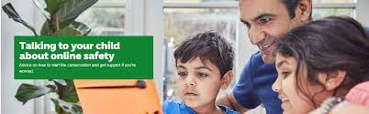
Hillside Infants School
How to discuss Online Safety with children

Slide 22
Hillside Infants School
Let your children teach you
The people who know best about what your children are up to online, are your children!
Get them to tell you about the sites they’re using. This is a good way to develop a trusting relationship with your child about what they are up to online.
Ask them questions such as:
Why do you like the site?
What can you do on it?
What’s so fun about it?
Who uses it at school?
Who can you talk to?
Who are your friends on it?

Slide 23
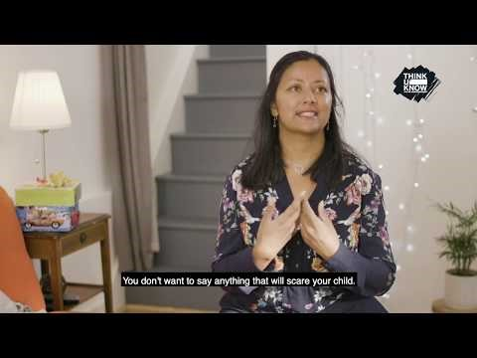
Hillside Infants School
www.thinkuknow.co.uk/parents

Slide 24
Hillside Infants School
Reach an agreement
A good way to set boundaries with your child about what they can and can’t do online is to set an agreement with them.
It is important that the children realise the importance of the agreement and that it is in place to help support and keep the child safe.
Here are some examples of the areas you might want to discuss:
Limits on the amount of time your child spends online
No bedroom rule
Having regular screen breaks
Not sharing any pictures they wouldn’t be happy to share with you.
Not giving out personal details
Coming to you if they are concerned. Or, if not, knowing where they can go for independent help and support.

Slide 25
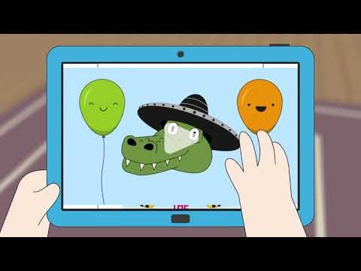
Hillside Infants School
Online Safety Video to share with children

Slide 26

Hillside Infants School
What tools and resources are there for support?

Slide 27
Hillside Infants School
Technical Tools
Parental controls on Computers and Mobile Devices
Parental controls on home broadband
Content lock on mobile networks
Child –friendly search engines
Turn off geo location settings on devices
Use the strongest privacy settings on social media

Slide 28
Hillside Infants School
Reporting Tools
Report online safety incidents to your school
Report online safety problems to the website where the incident happened
Report more serious case to CEOP. Child Exploitation and online protection. This should only be used in cases such as if your child has experienced sexual or offensive chat that has made them feel uncomfortable or someone is trying to meet up with them.
Ultimately in an emergency you should report the incident to the police.

Slide 29
Hillside Infants School
Online Resources
They are a range of good websites available to teach your child and yourself about online safety.
www.thinkuknow.co.uk/parents
www.nspcc.org.uk/preventing-abuse/keeping-children-safe/online-safety
www.childnet.com/resources/know-it-all-for-parents
www.internetmatters.org

Slide 30
Hillside Infants School
Top online safety tips
Talk to your child about what they are up to online.
Encourage your child to go online and explore!
Keep up-to-date with your child’s development online.
Set boundaries in the online world just as you would in the real world.
Keep all equipment that connects to the internet in a family space.
Know what connects to the internet and how.
Use parental controls on devices that link to the internet, such as the TV, laptops, computers, games consoles and mobile phones.
Explore the online resources available to keep yourselves up to date so you can support your children.

Slide 31
Hillside Infants School
School internet filter
Children's Internet access is heavily filtered by London grid for learnings Web screen platform which is a modified version of Light speed.
This includes YouTube filtering for age appropriate videos only.
The filter also logs searches for specific keywords under self harm, bullying, and various terms covered under Prevent. Reports are sent to network admins of any of the triggers are met for keyword access.
Computer accounts are password protected and endpoint malware and virus protection is provided by Sophos.

Slide 32
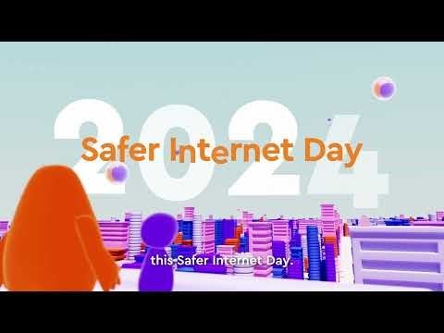
Hillside Infants School
Safer internet day
Celebrated in February every year – all over the world
Poster competition
Whole school assembly
Safer internet activities
Northwood High school – phone usage presentation

Slide 33
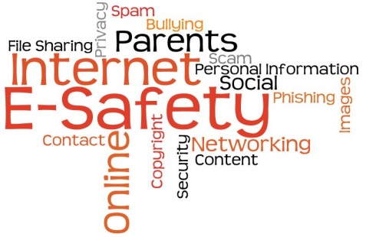
Hillside Infants School
Thank you for coming to this Online Safety Workshop and working in partnership with us to keep your children safe.

