Slide 1

Hillside Infant School
Supporting your child's Fine and gross motor skills

Slide 2

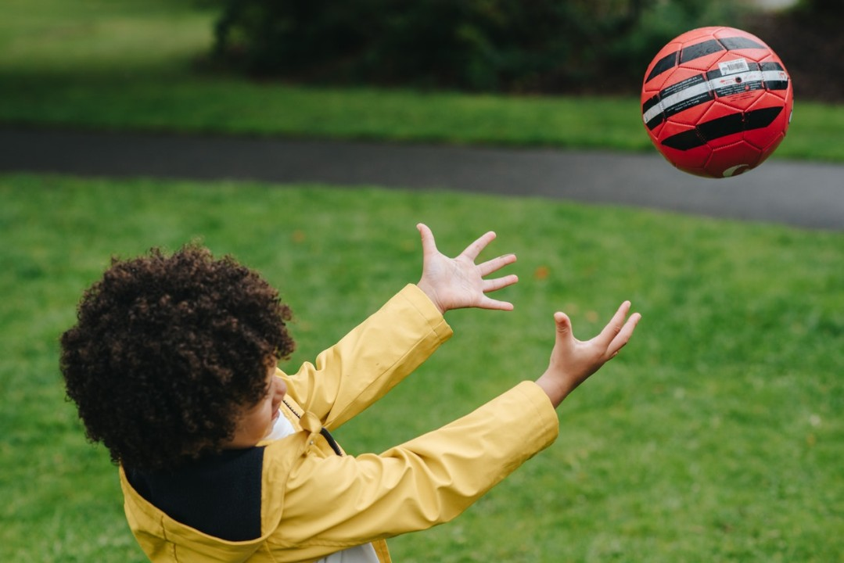
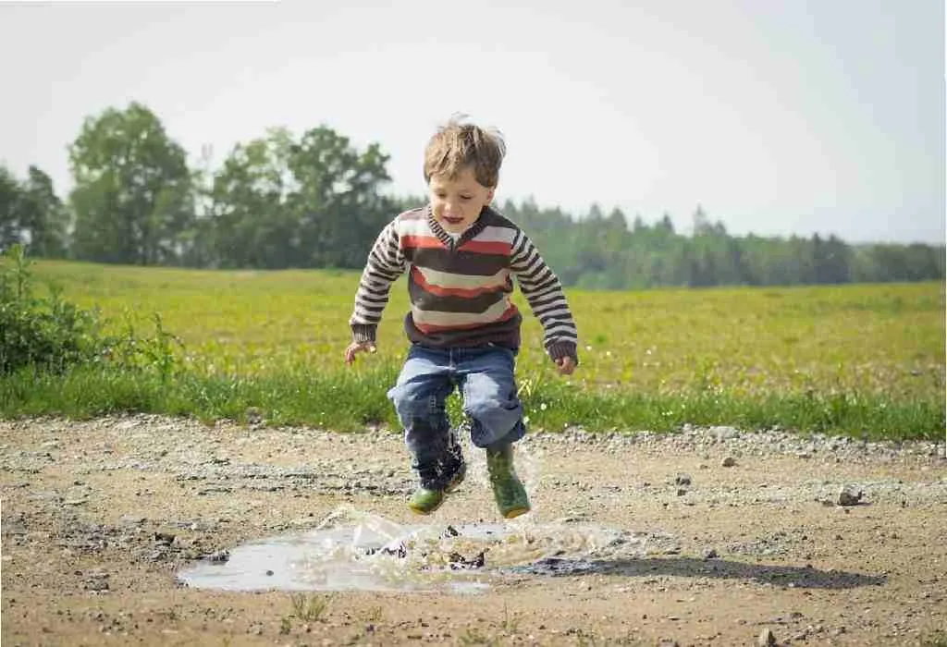
Hillside Infant School
What are gross motor skills?
It describes how a child is moving their whole body using large muscle groups.
Examples include; walking, running, jumping, swimming, throwing and catching a ball, climbing and cycling.

Slide 3
Hillside Infant School
Why are gross motor skills important?
Gross motor skills are important for overall physical development, posture, coordination and balance.
Learning these basic movements help children move from one position to another in a smooth and efficient manner.

Slide 4
Hillside Infant School
By the time your child starts nursery (3 years of age) they should be balancing, throwing, kicking a ball, jumping, running, climbing on and off equipment.

Slide 5

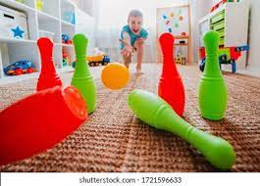

Hillside Infant School
What can you do?
Play ball games such as catch, kicking or throwing a ball at a target, throwing a ball through a hoop or bowling.
Bouncing on a trampoline is a fun activity for improving coordination.
Dance and gymnastics will help develop coordination and muscle strength

Slide 6



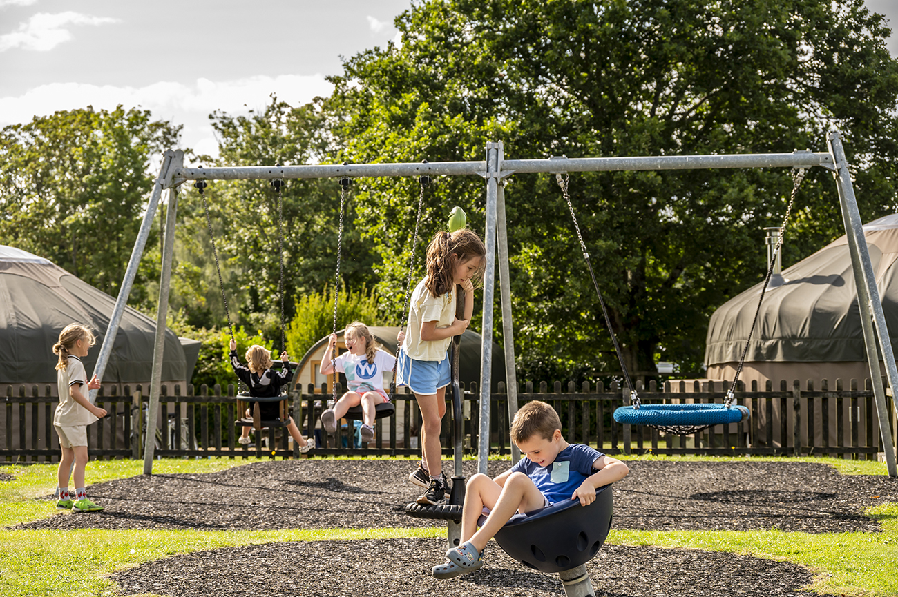
Riding on a scooter will help with core strength and balance
Visiting the park is a great way for your child to use a variety of different equipment to help develop their gross motor skills
Letting them take risks is important for their development

Slide 7
Hillside Infant School
What are Fine motor skills
Fine motor skills are the ability to make movements using the small muscles in our hands and wrists.
Developing fine motor skills helps children do things like eating, writing, manipulating objects and getting dressed.

Slide 8
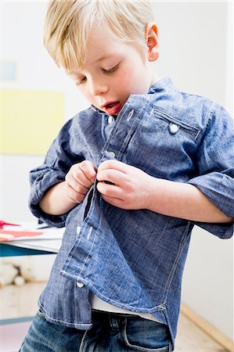


Hillside Infant School
Ways to Improve Children’s Fine Motor Skills
Encourage your child to feed themselves using a knife, fork and spoon
Encourage your child to get dressed on their own
Encourage arts and crafts; painting, colouring, drawing cutting and sticking

Slide 9


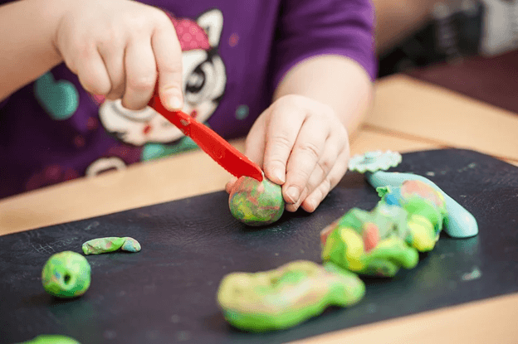
Play board games and puzzles with them
Construction play with large or smaller blocks
Create with Play-Doh – Dough Disco
https://www.youtube.com/watch?v=BOLR3pQt8zg

Slide 10

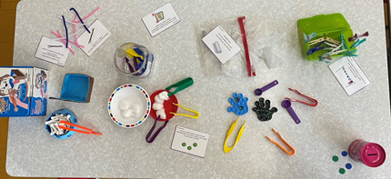
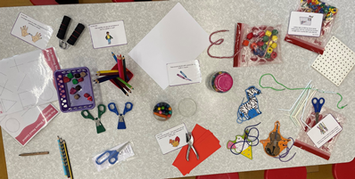
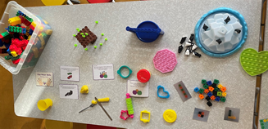
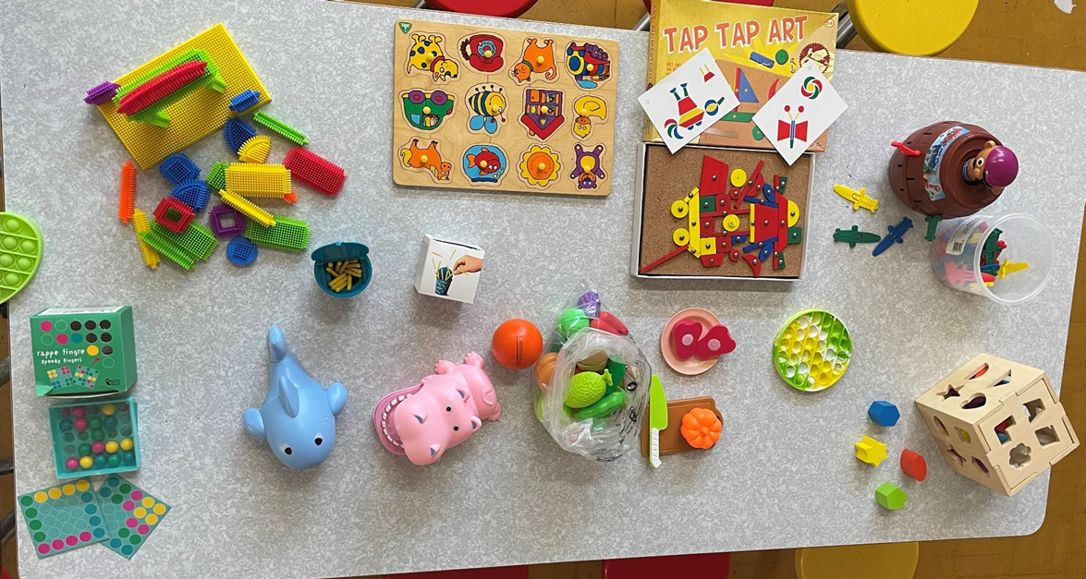
Encourage activities to strengthen fingers; peg boards, threading, tweezers, clothes pegs and shape sorting activities.

Slide 11
Hillside Infant School
Handwriting
Handwriting is a whole body skill!
To write we use both fine and gross motor skills!
If a child has weak core / posture / upper body strength / shoulder stability they will really struggle to write.
So that's why it is so important that we develop these skills from an early age!

Slide 12
Hillside Infant School
The Essential skills for Handwriting.....
Visual motor the ability to translate a visual image, or a visual plan, into an accurate motor action / movement
Visual perception the brain's ability to make sense of what the eyes see.
Fine motor the ability to make movements using the small muscles in our hands and wrists.
Trunk control the ability to control your upper body (your trunk or torso). It affects how well you can hold your body upright when sitting or moving.
Shoulder stability you have good shoulder stability, you'll be able to easily coordinate moving your arms in a smooth way – essential for handwriting

Slide 13
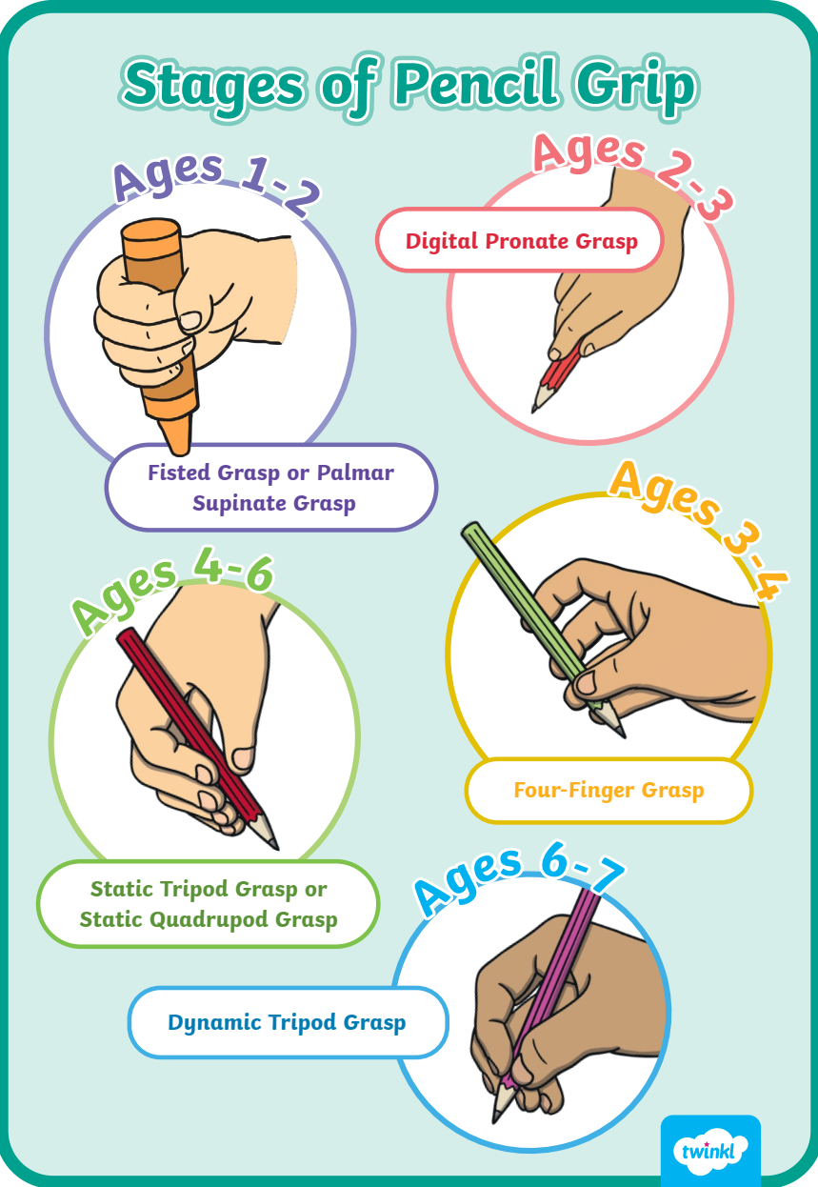
Hillside Infant School

Slide 14
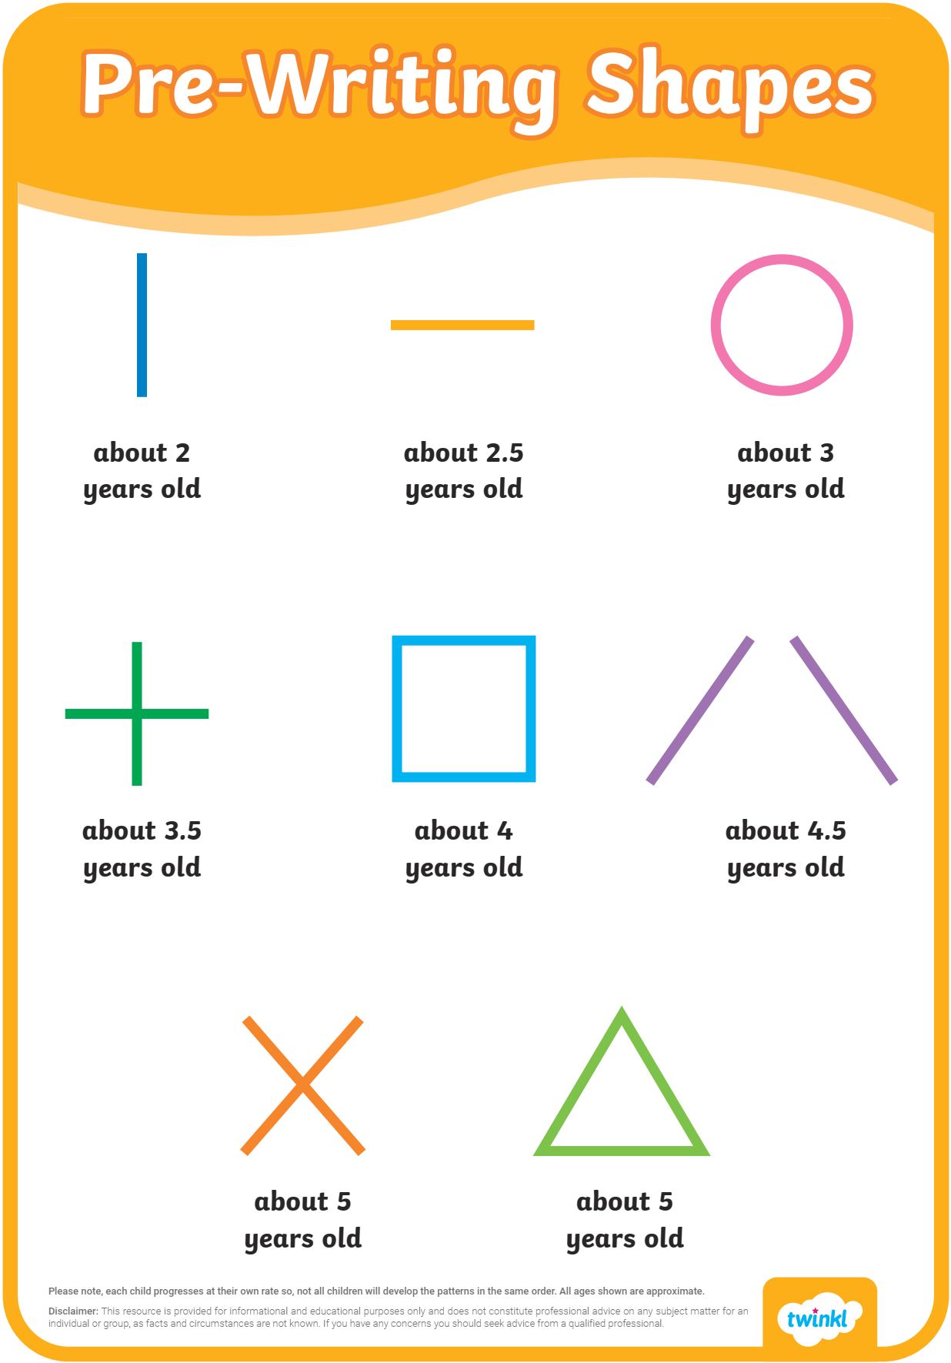

Slide 15
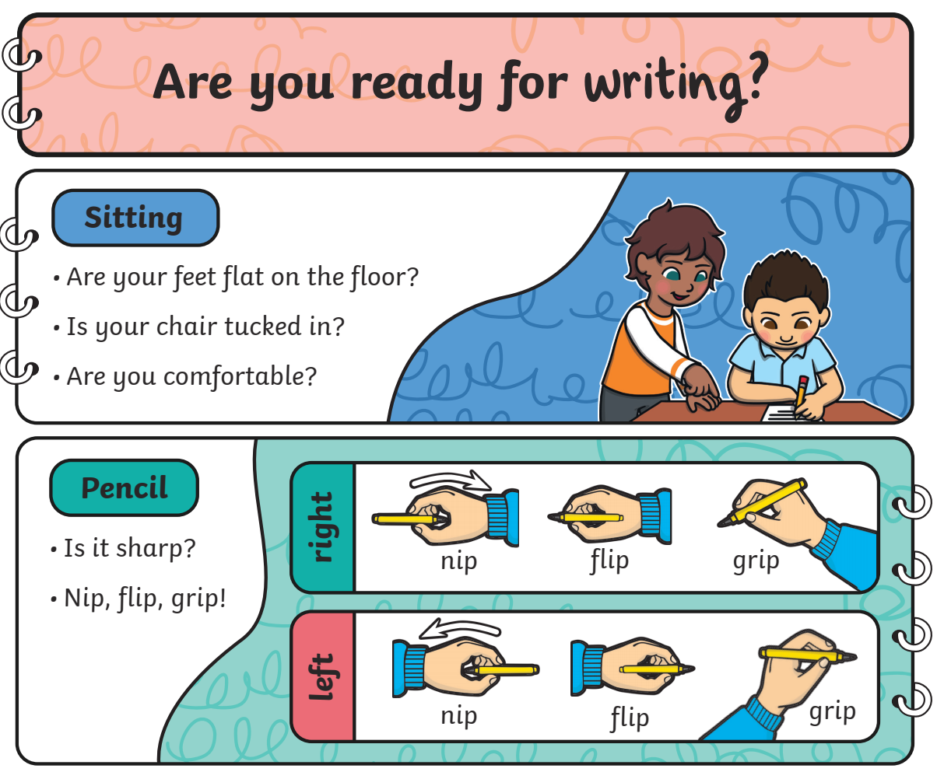

Slide 16
Thank you for coming!
Natalie Pugh – Pastoral care lead / DDSL
Emma Lloyd – Inclusion Therapist

