Slide 1

Getting ready for Reception
Wednesday 21st May 2025

Slide 2

Preparing your child for Reception
Starting Reception can be daunting for you and your child, but it does mark the start of an exciting new chapter!
There are key skills that we do expect children to be learning before they start Reception. You are lucky because our Nursery staff are already supporting your child with these key skills and have been since they started Nursery.
Continuing to practising these will make your child’s journey to Reception as positive as possible. There are ways that you can prepare your child and yourself for this time of change.
From now and throughout the summer holidays there are small steps you can take to make sure the transition happens in a smooth and relaxed manner.
There’s lots you can do at home to build your child’s confidence and independence, helping them feel emotionally and practically prepared to start school.
Here are our top tips for being Reception ready!

Slide 3
Tip 1
Positive talking
Help to develop your child's confidence and self belief. You can do it!
Remind your child of all the things they have already achieved in Nursery. The Nursery staff will also be doing this.
Always talk positively about moving up to Reception.
You have grown taller, defiantly ready for Reception!
You will make lots of new friends!
The teachers in Reception are super friendly!
You will eat lunch with your new friends!
You will play in the exciting Reception playground!

Slide 4
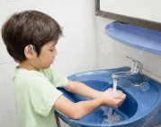


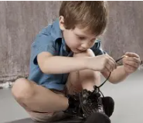
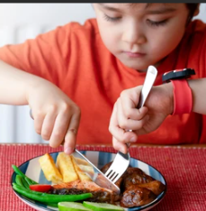
Tip 2
Independence
Support your child in being independent One of the most useful things you can do to get your child ready for school is to make sure they can carry out several practical tasks on their own
Washing their hands
Going to the toilet, wiping bottoms and pulling up underwear
Putting on coats and doing the zip up!
Putting on and taking them off shoes. (Velcro!)
Getting changed into their uniform or PE kits by themselves. Why not have a few practise runs
Taking off and putting on jumpers or cardigans.
Using a knife and fork and opening a lunchbox and its contents.

Slide 5

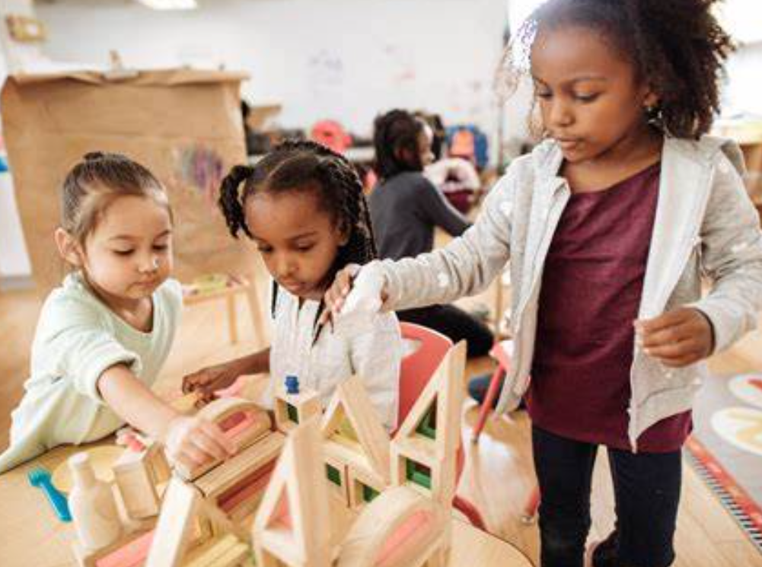

Tip 3
Develop your child’s interpersonal and cognitive skills
Children learn and develop by playing alongside their classmates and so it is important that they are happy mixing with other children and adults.
Encourage sharing and taking turns through games and conversations.
Practise talking and listening. Give your child your full attention when they speak and maintain eye contact - and hopefully they will listen to you too!
Try to solve problems with words; Let’s talk about it!
Children are natural copy cats. Let them see you reading or tidying up and they'll soon want to join in, or try a role-play.
Arrange play-dates and picnics to improve your child's social skills.
Build up your child’s concentration levels, a minute at a time, to focus on one activity. See if you can build up to 10 minutes. Maybe they could set a timer?
Practise following simple instructions.
Spend time with them on one activity, with no distractions, talking about what you are doing as you go along.
Develop a ‘have a go’ attitude and an understanding that it is ok to make mistakes, as we can learn from them.

Slide 6
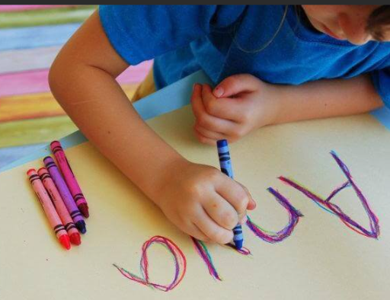
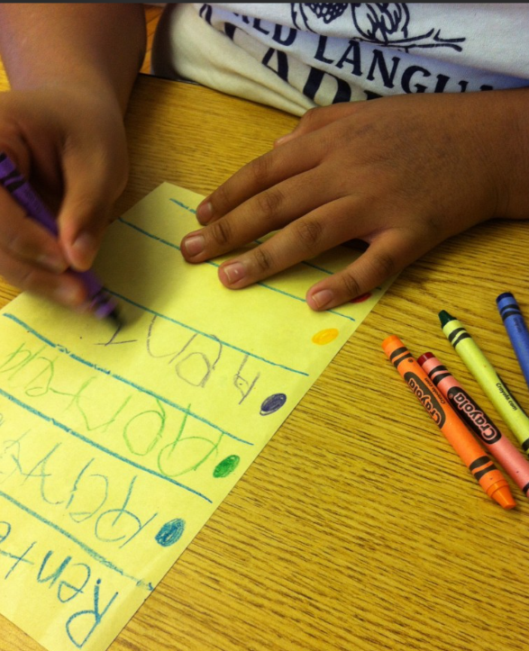

Tip 4
Early literacy skills
The staff in the Nursery are all ready working to build early Literacy skills. However, there are many easy things you can do at home to support your child’s learning:
Help them to recognise their name so that they can find their coat peg, their class tray, sign in name etc.
Help them to write their name.
Do lots of drawing and colouring to practise holding a pencil.
Talk with your child throughout the day and explain new words.
Share a book together every day, even if it’s just for a few minutes. Mix it up. Talk about pictures, characters and stories; find rhyming words or repeated phrases; guess what’s going to happen on the next page or make up new endings.
Develop a shared love of books. If your child sees you reading and enjoying books, they will too.

Slide 7


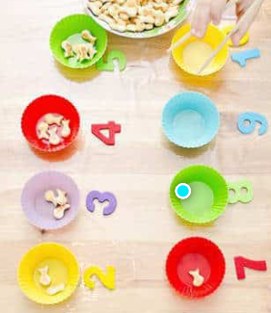
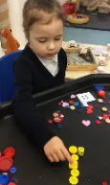

Tip 5
Early numeracy skills
The staff in the Nursery are all ready working to build early numeracy skills. However, there are many easy things you can do at home to support your child’s learning:
Introduce number through rhymes and songs like 5 little ducks.
Make and play number games like dominoes and hopscotch.
Count —everything — stairs at home, numbers on doors (great for counting in 2s), cars going past, birds in the park, and, if you’re lucky, toys as you put them away!
Do countdowns, to learn to count backwards!
Play games to recognise numbers to 5 – match objects to those numbers.
Play shape games to support recognising different shapes.

Slide 8
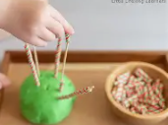
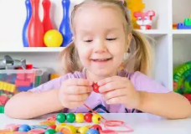




Tip 6
Fine and Gross Motor Skills
The staff in the Nursery are all ready working to build Fine and Gross motor skills. However, there are many easy things you can do at home to support your child’s learning:
Do lots of activities to support to strengthen your child’s muscles:
Playdough
Threading
Cutting
Using tweezers
Puzzles
Jumping, hoping, skipping, running, crawling
Riding a scooter or bike
Playing in the park
Climbing equipment
Playing chasing games

Slide 9
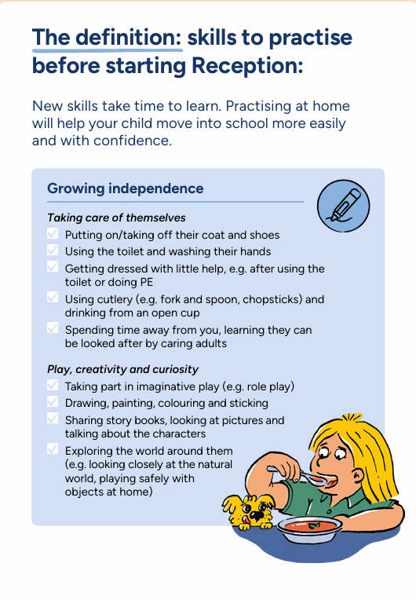
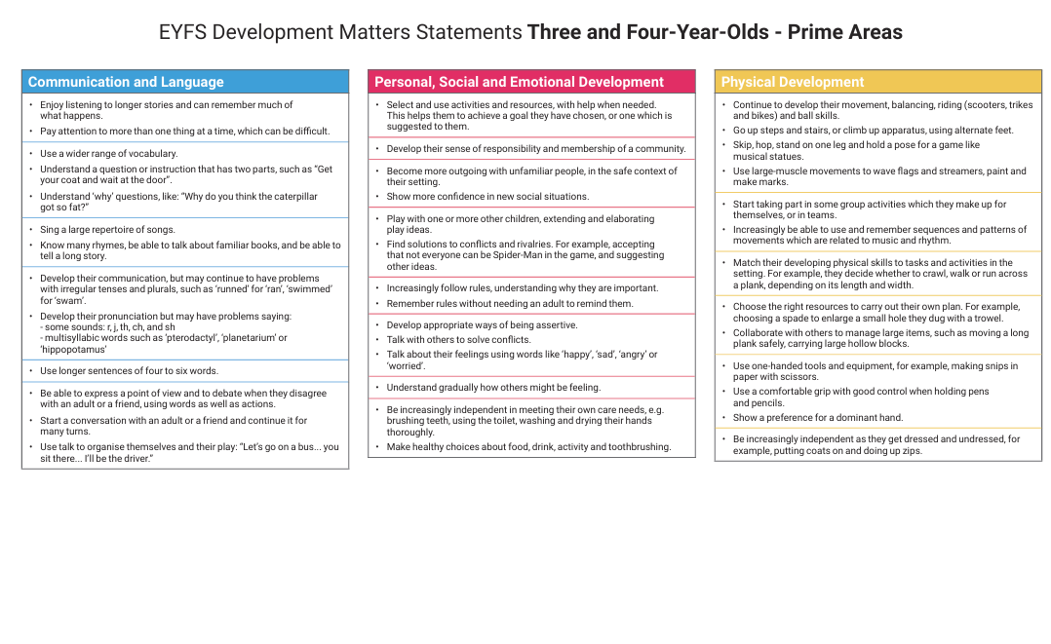
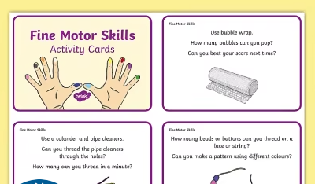
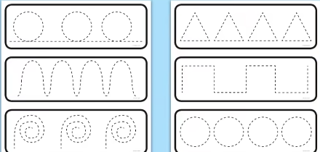
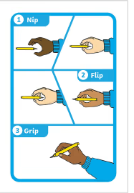
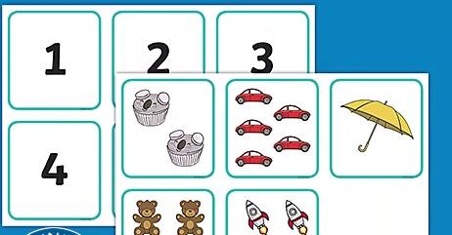
Home Learning Pack
You all will have a home learning pack with some helpful documents to help your child get ready for Reception.

Slide 10
Thank you for coming

