Slide 1
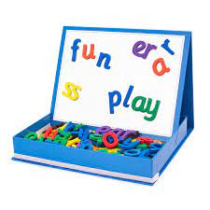
Wednesday 4th February
Targeted Phonic Workshop
Year 1

Slide 2
Please fill out part 1 of the questionnaire to begin with

Slide 3


By the end of the session we will…
Learn about phonemes and graphemes
Learn about blending and segmenting
Use our skills to read together
Learn how to support our children with phonics and help them to be better readers and writers

Slide 4
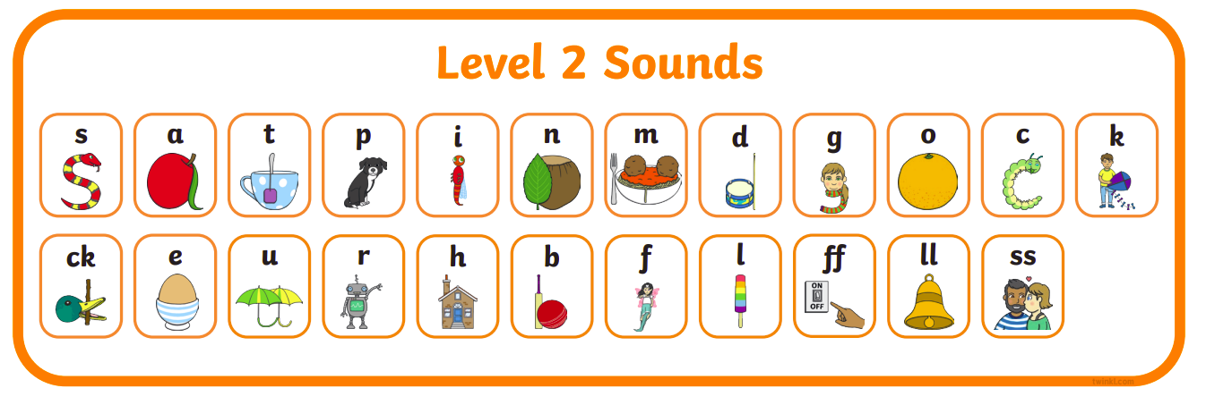
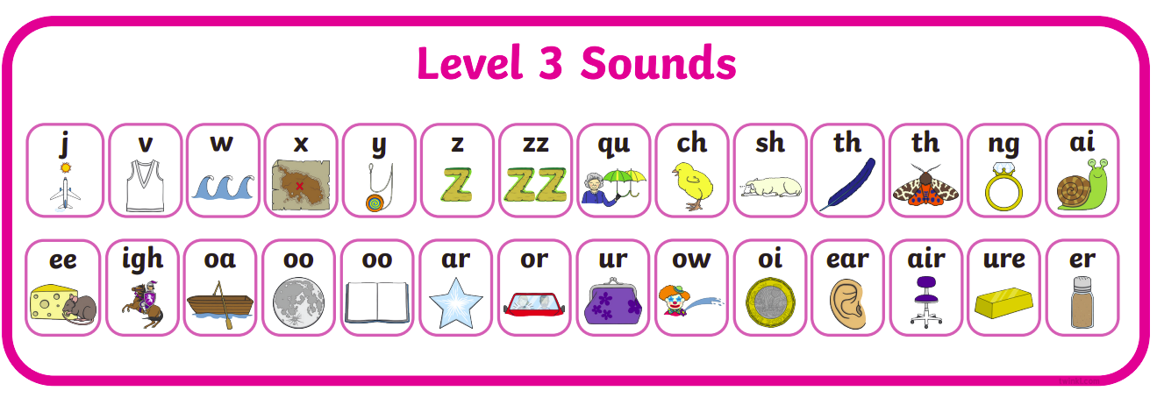
Phonemes
Each sound is called a phoneme.
Every time your mouth changes shape, it is a new phoneme.

Slide 5


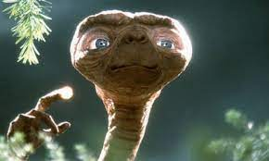
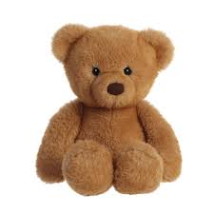
Graphemes
Each written sound is called a grapheme. English can be complicated because some phonemes have more than 1 grapheme e.g.
The sound “ee” can be made lots of different ways
dream bee alien teddy

Slide 6
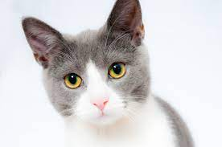

Blending and segmenting
Blending - Putting - sounds together to make a word - reading
Segmenting - pulling sounds apart - spelling
cat - c a t
d o g - dog
dream - d r ea m

Slide 7


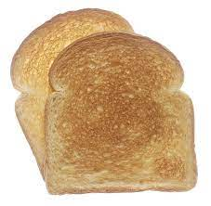

Phoneme Fingers
always encourage children to sound out before writing
How many phonemes?
Show me using your phoneme fingers
Let’s practise some together…

Slide 8
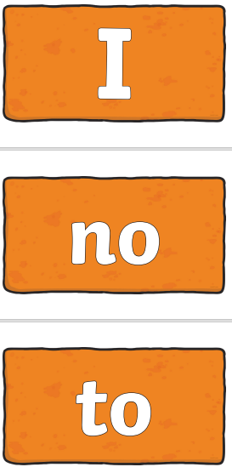
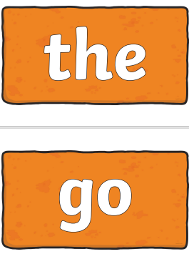
Tricky words
Tricky words cannot be sounded out - we just have to learn them. The quicker and more easily children can recognise these the better they will be able to read.
Practise these little and often
Use the words in context
I would like to go to the shop.

Slide 9
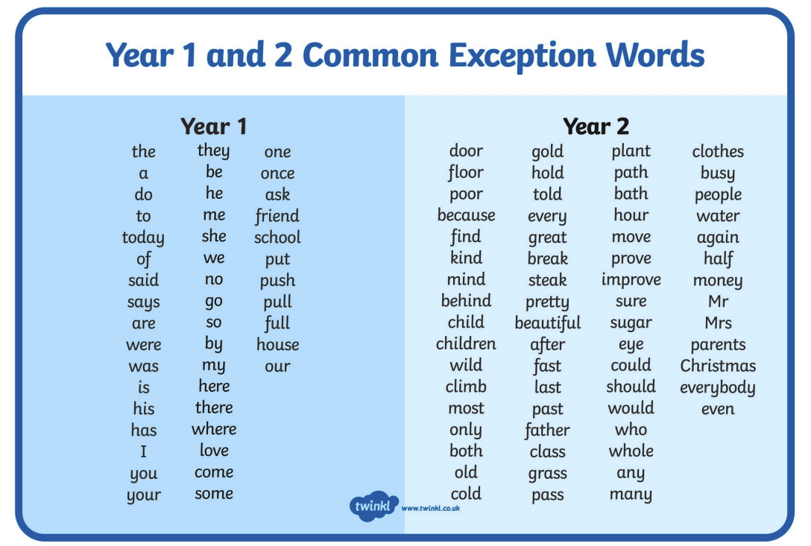

Slide 10
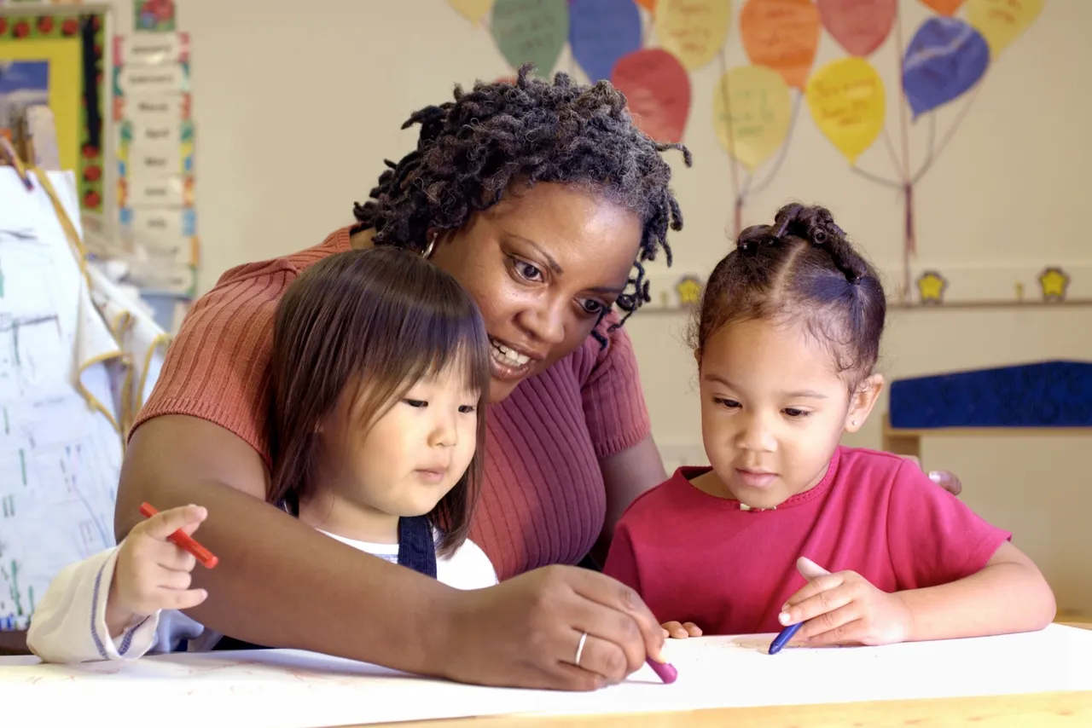
How to help struggling children
Read for 5 minutes every day
Allow them to write each day - a shopping list, a card, a recipe
Help them to learn tricky words
Help them split words into phonemes - segmenting and blending
Sing rhymes each day and tell them stories to help them enjoy reading and to train their ear to hear different sounds
Help them with their phonic homework each week
Praise any effort and don’t worry too much about them using an alternative sound. Just have a go.

Slide 11

Phonic Screening Check
Towards the end of Year 1, all children take a national phonic screening test to see if they can use their phonemes to sound out real and fake words.
If children don’t achieve the pass mark, they retake the test in Year 2.
Here is an example of a past Phonics Screening Check…

Slide 12
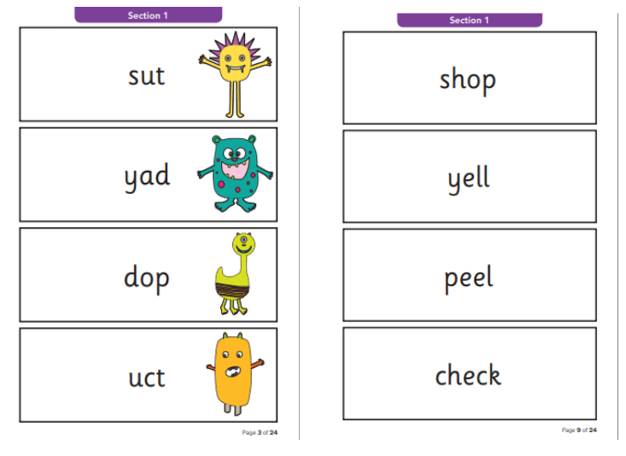

Slide 13


Slide 14
The game below will give you an idea of the kinds of words children will need to read. The words get harder as the test goes on.
https://www.phonicsplay.co.uk/resources/phase/2/buried-treasure

Slide 15

Please fill in part 2 of the questionnaire.
Any questions?

