Slide 1

Hillside Infant School
Phonics Workshop
Wednesday 9th October 2024
Notes:
CO

Slide 2

Hillside Infant School
This workshop will look at the following:
What is phonics?
How do children learn phonics in school?
How is phonics assessed?
How can I help my child?
Notes:
CO

Slide 3
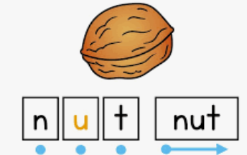
Hillside Infant School
What is phonics?
Phonics teaches children to identify phonemes (sounds) that make up each word – each sound is represented by 1 or more graphemes (letters)
A phoneme is made every time your mouth changes shape
Children learn;
Decoding for
reading by blending phonemes
Segmenting for writing
Notes:
KM

Slide 4



Hillside Infant School
What makes phonics tricky?
The English language has 44 phonemes (sounds)
There are over 140 different ways of
writing these phonemes.
Some phonemes are written using more than one grapheme (letter)
    2 graphemes is a digraph e.g. ch, sh.
3 graphemes is a trigraph e.g. ear, igh.
Some graphemes can represent more than one sound. e.g., ea makes different sounds in each of these words – tea, bread, steak
Notes:
Language = a code
Teaching phonics enables children to crack the code
Parents haven’t learned phonics – but can easily!

Slide 5

Hillside Infant School
Key terms and features
phoneme- the smallest unit of sound in a word
grapheme- the written representation of a phoneme
Phoneme Fingers for blending and segmenting
https://www.youtube.com/watch?v=Ii2GO11xjcU
Notes:
https://www.youtube.com/watch?v=BqhXUW_v-1s

Slide 6
Hillside Infant School
Level 1: Nursery
Phase one comprises of 7 aspects.
1. Environmental Sounds
2. Instrumental Sounds
3. Body Percussion
4. Rhythm and Rhyme
5. Alliteration
6. Voice Sounds
7. Oral Blending and segmenting
Notes:
We follow the Letters and Sounds programme – systematic six-phase teaching programme
aimed at securing fluent word recognition skills by the end of Key Stage 1
Expectations for end of

Slide 7
Hillside Infant School
Level 2
Children learn 19 sounds:
Set 1: s, a, t, p Set 4: ck, e, u, r
Set 2: i, n, m, d Set 5: h, b, f, ff, l, ll, ss
Set 3: g, o, c, k
Children learn another 25 sounds:
Set 6: j, v, w, x Set 7: y, z, zz, qu
Consonant digraphs: ch, sh, th, ng
Vowel digraphs: ai, ee, oa, oo, ar, or, ur, ow, oi, er
Trigraphs: ear, air, ure, igh
Level 3
Notes:
Sounds are not taught in alphabetical order

Slide 8
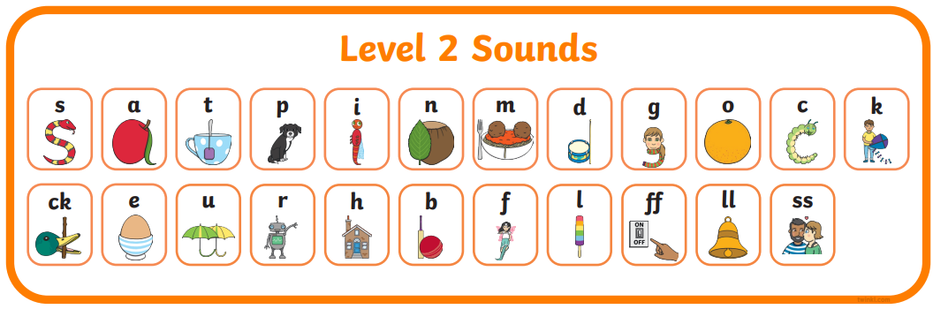
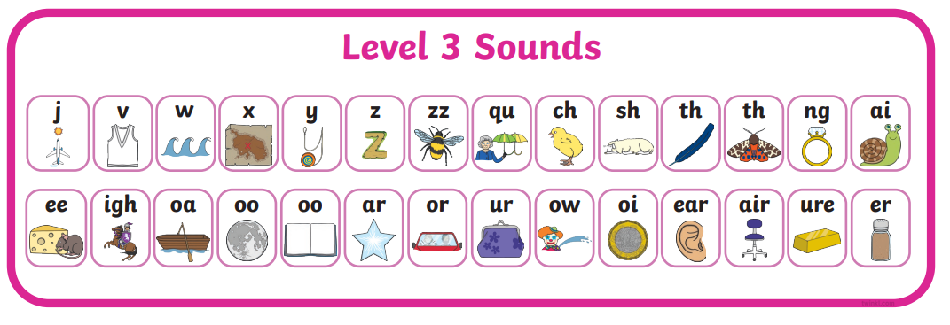
Hillside Infant School
Notes:
Language = a code
Teaching phonics enables children to crack the code
Parents haven’t learned phonics – but can easily!

Slide 9
Hillside Infant School
Level 4
Children move into level 4 when they know all the phonemes from levels 2 and 3 and can use them to read and spell simple words (blending to read and segmenting to spell).
Level 4 doesn’t introduce any new phonemes.
It focuses on reading and spelling longer words with the phonemes they already know.
These words have consonant clusters at the beginning:
spot, trip, clap, green, clown
…or at the end: tent, mend, damp, burnt
…or at the beginning and end! trust, spend, twist

Slide 10
Hillside Infant School
Level 5
children learn new graphemes for reading
ay, ou, ie, ea, oy, ir, ue, aw, wh, ph, ew, oe, au,
a-e, e-e, i-e, o-e, u-e
They learn alternative pronunciations of graphemes (the same grapheme can represent more than one phoneme):
Fin/find, hot/cold, cat/cent, got/giant, but/put,
cow/blow, tie/field, eat/bread, farmer/her, hat/what,
yes/by/very, chin/school/chef, out/shoulder/could/you.
We aim to have most children completing level 5 by the end of Year 1.
Notes:
Practise reading and spelling common exception words
Practise reading and writing sentences

Slide 11
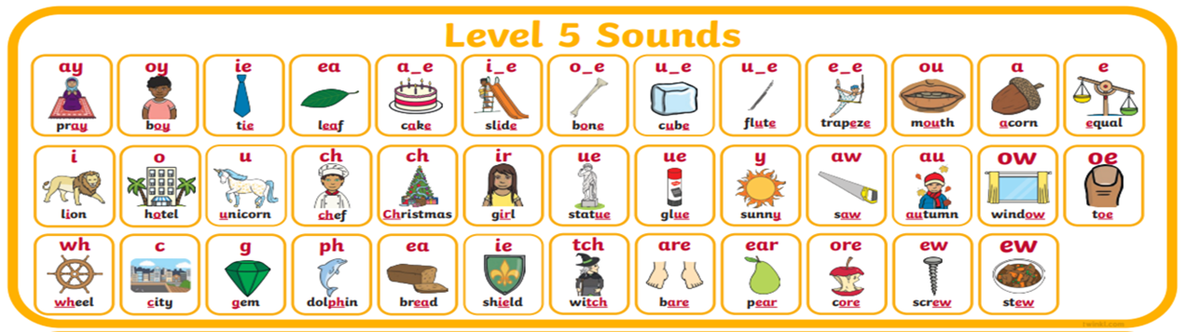
Hillside Infant School
Notes:
Language = a code
Teaching phonics enables children to crack the code
Parents haven’t learned phonics – but can easily!

Slide 12
Hillside Infant School
Level 6
By the beginning of Level Six, children should know most of the common grapheme– phoneme correspondences (GPCs).
They should be able to read hundreds of words, doing this in three ways:
■ reading the words automatically if they are very familiar;
■ decoding them quickly and silently because their sounding and blending routine is now well established;
■ decoding them aloud.
Children’s spelling should be phonemically accurate, although it may still be a little unconventional at times.
Children will learn how words change from present to past tense by applying prefixes and suffixes to route words e.g.
prefixes such as - undo, dislike,
suffixes such as – helped, liking
During this level, children become fluent readers and increasingly accurate spellers

Slide 13
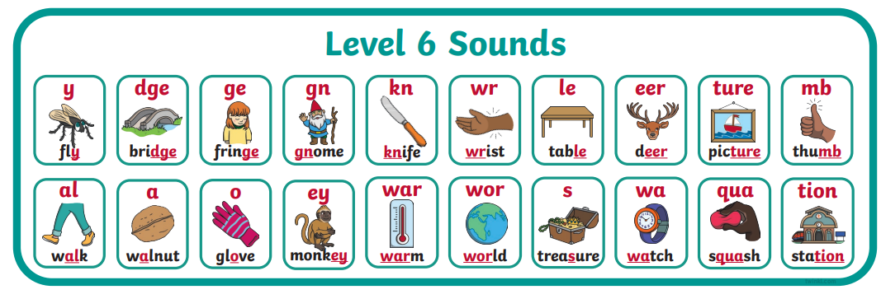
Hillside Infant School
Recap levels 1-5
Focus is to build accuracy and fluency in reading
Spelling patterns and rules to support accuracy with spelling
Notes:
Language = a code
Teaching phonics enables children to crack the code
Parents haven’t learned phonics – but can easily!

Slide 14

Hillside Infant School
Your children will learn to use the term:
Blending
Children need to be able to hear the separate sounds in a word and then blend them together to say the whole word .
b e d = bed
t i n = tin
m u g = mug
sh u t = shut
t r ee = tree
m oo n = moon
Notes:
Language = a code
Teaching phonics enables children to crack the code
Parents haven’t learned phonics – but can easily!

Slide 15

Hillside Infant School
Your children will learn to use the term:
Segmenting
Children need to be able to hear a whole word and say every sound that they hear
shut = sh u t
tree = t r ee
moon = m oo n
bed = b e d
tin= t i n
mug= m u g
Notes:
Language = a code
Teaching phonics enables children to crack the code
Parents haven’t learned phonics – but can easily!

Slide 16

Hillside Infant School
Tricky words
There are many words that cannot be blended or segmented because they are irregular.
the was said you some
https://www.google.com/search?q=tricky+word+songs&rlz=1C1CHBF_en-gbGB976GB989&oq=tricky+word+songs&aqs=chrome..69i57j0i512l3j0i22i30j0i390i650l2.4690j0j9&sourceid=chrome&ie=UTF-8
Notes:
Language = a code
Teaching phonics enables children to crack the code
Parents haven’t learned phonics – but can easily!

Slide 17
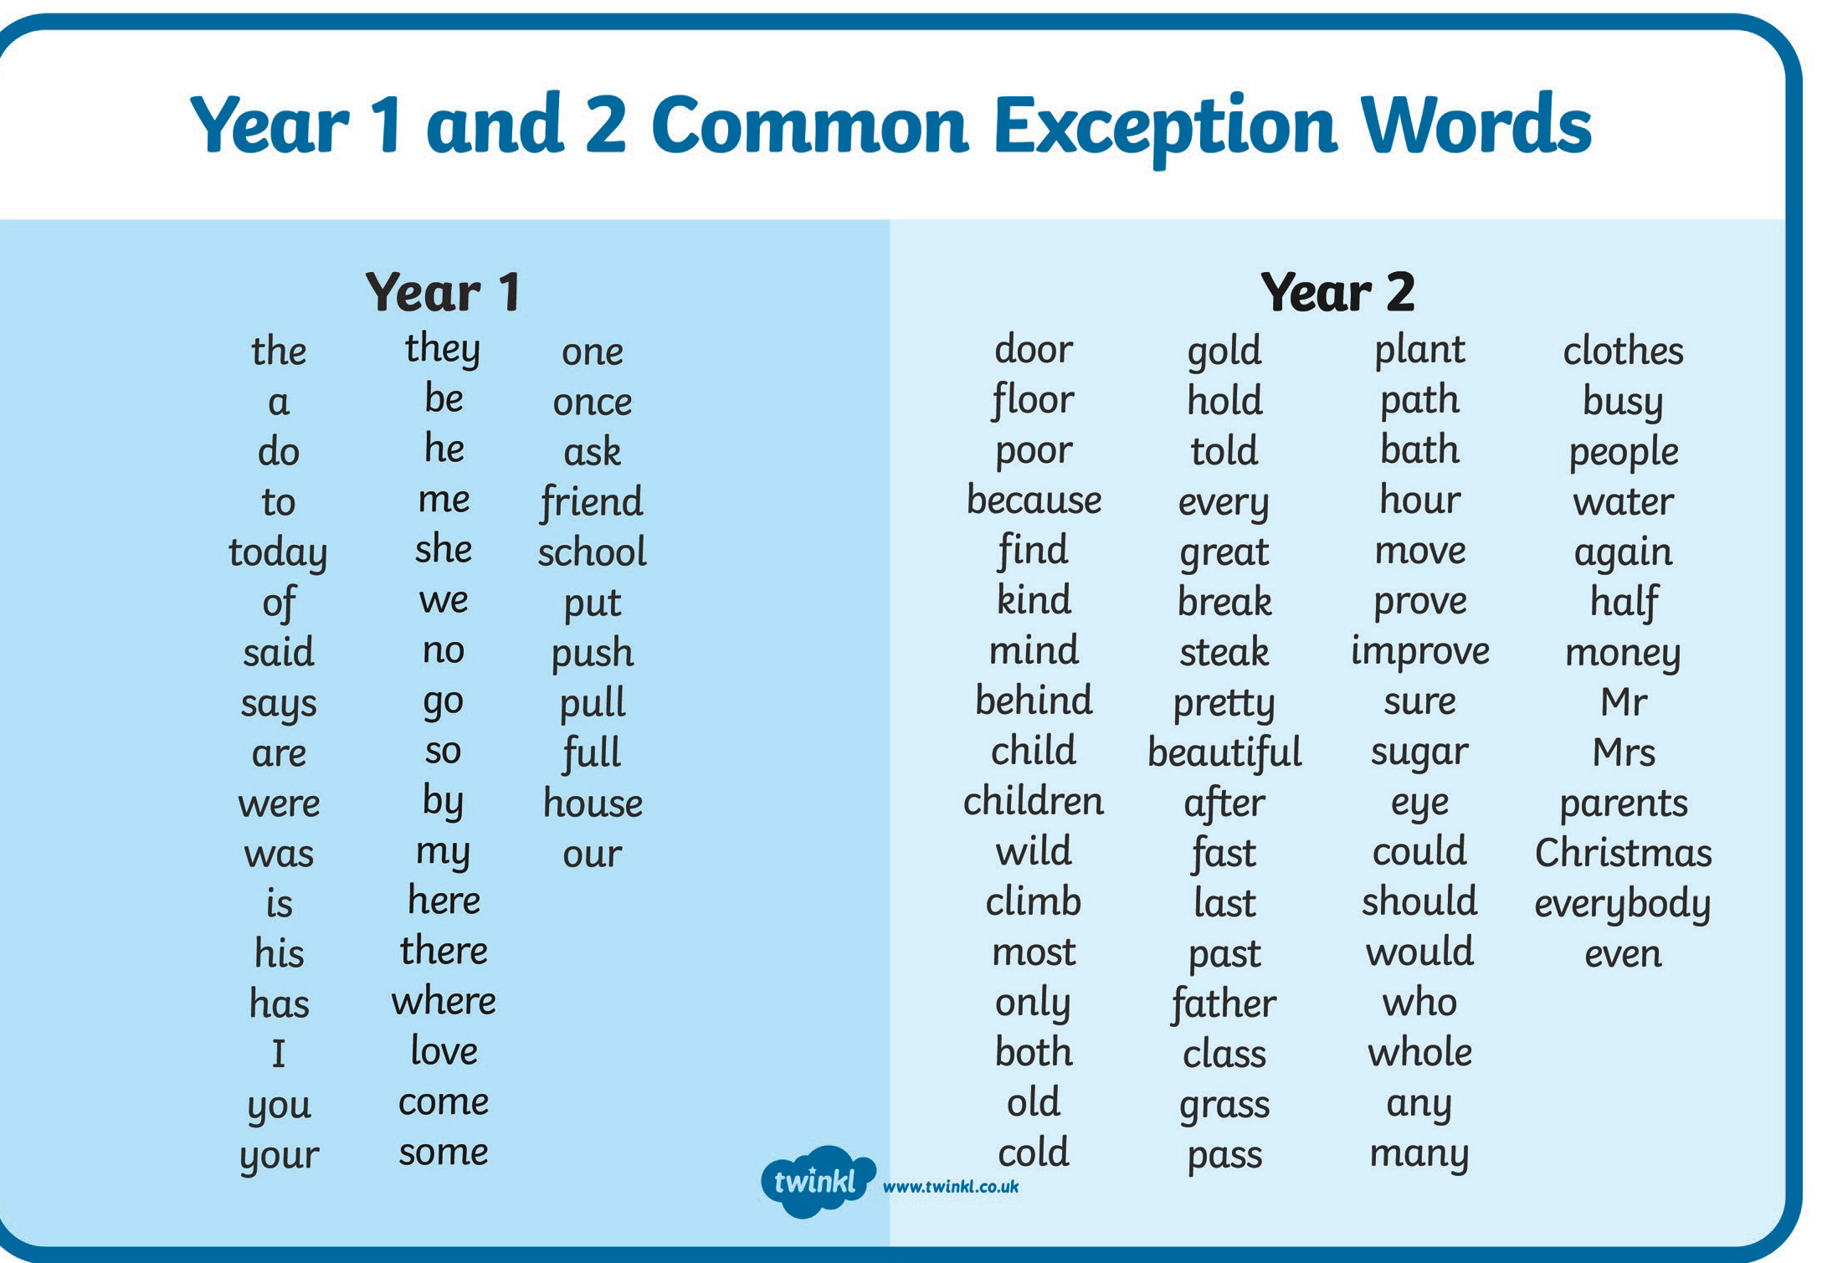
Hillside Infant School
Notes:
Language = a code
Teaching phonics enables children to crack the code
Parents haven’t learned phonics – but can easily!

Slide 18
Hillside Infant School
How do children learn phonics in school?
Daily phonics lesson – 20 minutes – Twinkl phonics (Review, teach, practise and apply)
Grouped according to child’s needs-
teaching focuses specifically on next steps for children in the group
Children are given regular opportunities to apply phonic skills in daily reading and writing lessons and in other areas of the curriculum

Slide 19
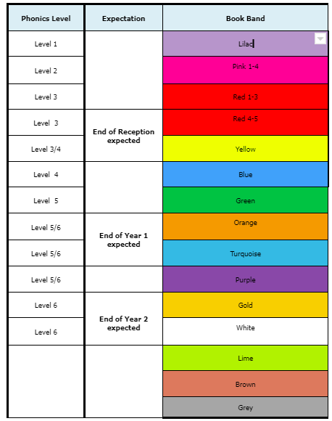
Hillside Infant School
Book bands
Our reading books support our phonic teaching to enable children to read increasingly independently and successfully
Books are matched closely to their phonics level

Slide 20

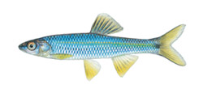
Hillside Infant School
Phoneme frames and sound buttons
c | a | t
. . .
f | i | sh
. . _
Notes:
Sounds are not taught in alphabetical order

Slide 21
Hillside Infant School
Have a go at these words.
log cut
duck shop
fill light
Notes:
Sounds are not taught in alphabetical order

Slide 22
Hillside Infant School
l | o | g
c | u | t
d | u | ck
sh | o | p
f | i | ll
l | igh | t
Notes:
Sounds are not taught in alphabetical order

Slide 23

Hillside Infant School
Helping your child at home
Say the sounds correctly
https://www.youtube.com/watch?v=BqhXUW_v-1s
Do not add an uh to the end of consonant sounds – say mmm not muh, lll not lluh – no schwa
Support your child to learn the sounds using flashcards or website games e.g. www.phonicsplay.co.uk – children need to recognise sounds at speed.
Notes:
Avoid overemphasis of sounds – makes blending easier

Slide 24
Hillside Infant School
Helping your child at home
Practise
Oral blending: the robot game
Children need to practise hearing a series of spoken sounds and merging them together to make a word.
For example, you say ‘b-u-s’, and your child says ‘bus’.
Or you say words in sentences like ‘what a w-i-n-d-y day’ for your child to hear and blend the sounds together to hear words.

Slide 25

Hillside Infant School
Helping your child at home
Segmenting for Spelling
REMEMBER - Segmenting is the opposite of blending
Children say a word and break it up into sounds (phonemes) so that they can spell it
We use phoneme fingers for this
sh i p
Children learn to say the word for writing and hold up one finger for each sound (phoneme) in the word
Notes:
Phoneme fingers
Other examples: shirt, cloud, drawer

Slide 26

Hillside Infant School
Helping your child at home
Reading
Read with your child every day and sign their home school diary – comment on your child’s reading – this really helps to know how children are doing at home.
If your child gets stuck and is struggling to blend the sounds, say the sounds yourself, quickly, until your child can hear the word!
(Only beginner readers need to sound out every word as they read all the time).
Make sure that your child sees you reading. Children like to copy what their parents do, if they see you reading then they are more likely to want to read too.
Remember bedtime stories are an important time together.
Make up your own stories together.
Visit the library so that your child regularly gets to see new books.
Notes:
Model use of sound buttons
Once secure with blending, encourage to read the word without sounding it out – just say it!

Slide 27
Hillside Infant School
Helping your child at home
Learning and practising common exception words?
These are everyday words that cannot be read or spelt using phonics
Children have to learn to read and write these words
How…
SAY the word with your child
Look at the ‘tricky’ part of the word for example: said
Find the easy bits using phonics: said
Identify the ‘tricky’ part of the word said (ai is not making ‘ay’ sound) Remember the tricky part
Learning common exception words
Group ‘tricky’ words that have the same ‘tricky’ part
for example: he, me, she, we, be
We call these word families
Notes:
Phoneme fingers
Other examples: shirt, cloud, drawer

Slide 28
Hillside Infant School
Helping your child at home
Websites:
www.phonicsplay.co.uk
https://www.oxfordowl.co.uk/for-home
Notes:
More independent readers, reading longer texts with more complex words with increasing fluency – confident applying phonic skills

Slide 29
Hillside Infant School
How do we assess phonics?
In each phonics lesson, teachers and teaching assistants will be observing and using target questions to check learning.
Every time an adult reads with a child, they will be assessing their learning.
There will be daily opportunities for reading and writing in class.
In Year 1, children will take part in the national phonic screening check.
Notes:
More independent readers, reading longer texts with more complex words with increasing fluency – confident applying phonic skills

Slide 30

Hillside Infant School
What is the Year 1 Phonic Screening Check?
Every Year 1 child in the country takes the Phonics Screening Check during the same week in June.
It gives parents and teachers information on how your child is progressing in phonics
It helps to identify whether your child needs extra help at this stage so that they do not fall behind in their reading

Slide 31
Hillside Infant School
What do children have to do in the Phonic Screening Check?
Your child will sit with a teacher. They have to read 40 words aloud – 20 real words and 20 non-words
The check usually takes 5-10 minutes
Children have experience of screening checks throughout Year 1

Slide 32
Hillside Infant School
Phonic Screening Check Results
Phonic screening check results are reported to the local authority and to parents in pupil school reports at the end of the summer term
If your child’s score falls below the required standard, the school will let you know how additional support will be given in Year 2 to help your child to catch up.
Children can re-take the Phonics Screening Check in Year 2.

Slide 33

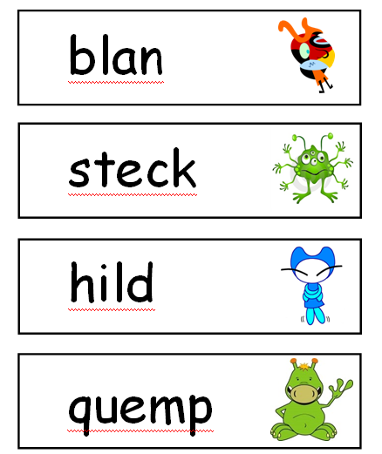
Hillside Infant School
Examples from the phonic screening check

Slide 34
Hillside Infant School
Final thoughts…
Please continue to read with your child each night and encourage them to:
sound words out from left to right
re-read words to check they make sense
use pictures for clues
ask questions about books
and most importantly…

Slide 35

Hillside Infant School
Final thoughts…
Enjoy reading and writing with your child!
Read a variety of texts. Fiction, non-fiction, poetry and texts in the environment
Opportunities for home writing – shopping lists, invitations, known stories & fairy tales, letters, cards, postcards

Slide 36

Hillside Infant School
Any questions?

