Slide 1


Hillside Infant School
Learning To Read Workshop
Friday 17th October
Notes:
CO

Slide 2

Hillside Infant School
Promote the love of reading through a range of platforms
Helps children find out information
Reading the world around them
Access learning in all areas of the curriculum
Notes:
CO

Slide 3

Hillside Infant School
This workshop will look at the following:
What is phonics?
How do children learn phonics in school?
How is phonics assessed?
How can I help my child?
Notes:
CO

Slide 4
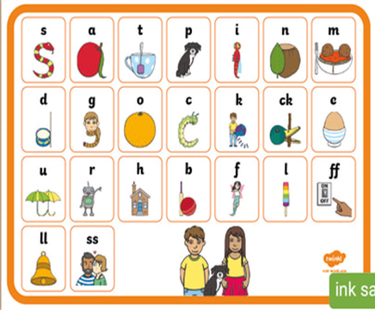
Hillside Infant School
Twinkl phonics
The children will be learning the sound each letter makes to support their reading and writing
Notes:
CO

Slide 5
Hillside Infant School
What is phonics?
Link between the sounds we say and the letters that represent each sound.
Grapheme – the written letter or groups of letters e.g. sh
Phoneme – the sound the grapheme makes
Blending – saying phonemes together to make a word e.g. sh o p m a t
Clear enunciation is essential!
https://www.youtube.com/watch?v=Ii2GO11xjcU
Notes:
KM

Slide 6
Hillside Infant School
Parents as Partners
Building positive relationships between home and school is essential in developing confident young readers. Working together is vital from the very start of every child’s time in school.
Notes:
KM

Slide 7

Hillside Infant School
Reading at Home
Be positive and celebrate successes
Model your love of reading!
Demonstrate how to read a text – left to right, turning pages
Ask questions about what has happened and characters feelings’
Support vocabulary, make predictions
Notes:
KM

Slide 8
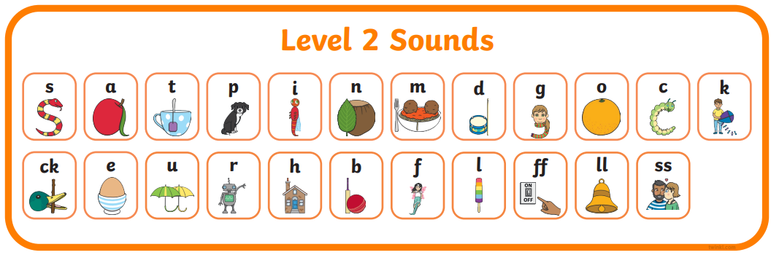
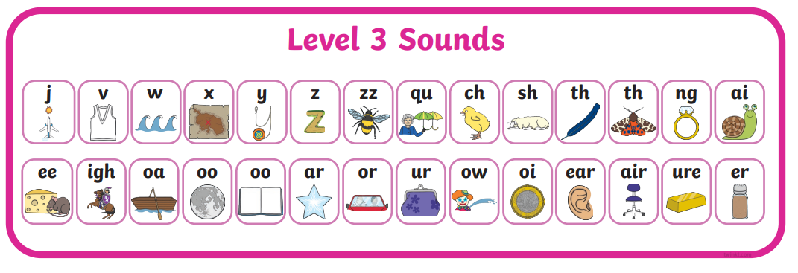
Hillside Infant School
Notes:
Language = a code
Teaching phonics enables children to crack the code
Parents haven’t learned phonics – but can easily!

Slide 9
Hillside Infant School
Level 4
Children move into level 4 when they know all the phonemes from levels 2 and 3 and can use them to read and spell simple words (blending to read and segmenting to spell).
Level 4 doesn’t introduce any new phonemes.
It focuses on reading and spelling longer words with the phonemes they already know.
These words have consonant clusters at the beginning:

Slide 10

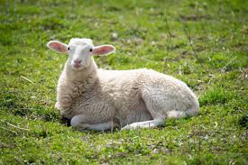

Hillside Infant School
Key Skills in Phonics
Blending
Segmenting
Notes:
Sounds are not taught in alphabetical order

Slide 11


Hillside Infant School
Phoneme Fingers
Notes:
Sounds are not taught in alphabetical order

Slide 12
Hillside Infant School
Let’s have at go at blending these words
log cut
duck shop
fill light
Notes:
Sounds are not taught in alphabetical order

Slide 13



Hillside Infant School
Let’s have at go at segmenting these words
Notes:
Sounds are not taught in alphabetical order

Slide 14
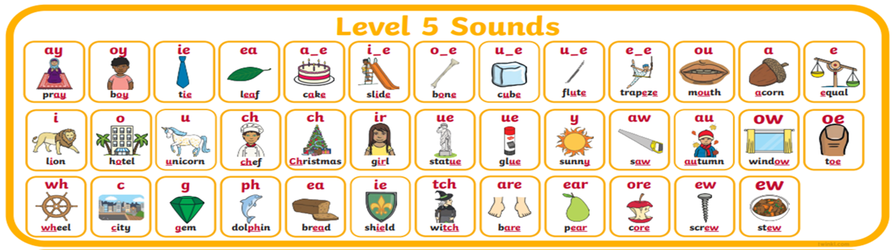
Hillside Infant School
Year 1 Ready!
Notes:
Language = a code
Teaching phonics enables children to crack the code
Parents haven’t learned phonics – but can easily!

Slide 15

Hillside Infant School
Tricky words
There are many words that cannot be blended or segmented because they are irregular.
the was said you some
https://www.google.com/search?q=tricky+word+songs&rlz=1C1CHBF_en-gbGB976GB989&oq=tricky+word+songs&aqs=chrome..69i57j0i512l3j0i22i30j0i390i650l2.4690j0j9&sourceid=chrome&ie=UTF-8
Notes:
Language = a code
Teaching phonics enables children to crack the code
Parents haven’t learned phonics – but can easily!

Slide 16
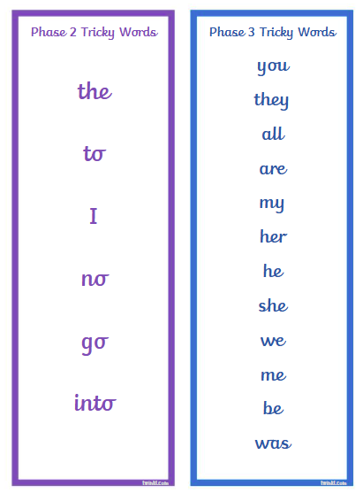
Hillside Infant School
Notes:
Language = a code
Teaching phonics enables children to crack the code
Parents haven’t learned phonics – but can easily!

Slide 17

Hillside Infant School
Helping your child at home
Say the sounds correctly
https://www.youtube.com/watch?v=BqhXUW_v-1s
Do not add an uh to the end of consonant sounds – say mmm not muh, lll not lluh – no schwa
Support your child to learn the sounds using flashcards or website games e.g. www.phonicsplay.co.uk – children need to recognise sounds at speed.
Notes:
Avoid overemphasis of sounds – makes blending easier

Slide 18
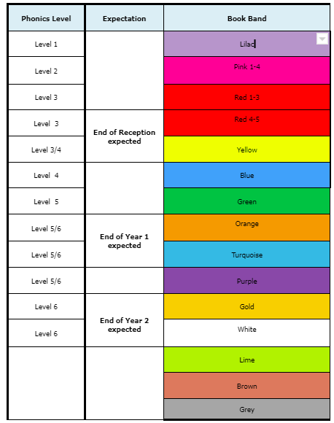
Hillside Infant School
Book bands
Children’s reading books are from different reading schemes
Our reading books support our phonic teaching to enable children to read increasingly independently and successfully

Slide 19
Hillside Infant School
Helping your child at home
Practise
Oral blending: the robot game
Children need to practise hearing a series of spoken sounds and merging them together to make a word.
For example, you say ‘b-u-s’, and your child says ‘bus’.
Or you say words in sentences like ‘what a w-i-n-d-y day’ for your child to hear and blend the sounds together to hear words.

Slide 20

Hillside Infant School
Helping your child at home
Segmenting for Spelling
REMEMBER - Segmenting is the opposite of blending
Children say a word and break it up into sounds (phonemes) so that they can spell it
We use phoneme fingers for this
sh i p
Children learn to say the word for writing and hold up one finger for each sound (phoneme) in the word
Notes:
Phoneme fingers
Other examples: shirt, cloud, drawer

Slide 21

Hillside Infant School
How do we assess phonics?
In each phonics lesson, teachers and teaching assistants will be observing and using target questions to check learning.
Every time an adult reads with a child, they will be assessing their learning.
There will be daily opportunities for reading and writing in class.
In Year 1, children will take part in the national phonic screening check.
Notes:
More independent readers, reading longer texts with more complex words with increasing fluency – confident applying phonic skills

Slide 22

Hillside Infant School
Helping your child at home
Reading
Read with your child every day and sign their home school diary – comment on your child’s reading – this really helps to know how children are doing at home.
If your child gets stuck and is struggling to blend the sounds, say the sounds yourself, quickly, until your child can hear the word!
(Only beginner readers need to sound out every word as they read all the time).
Make sure that your child sees you reading. Children like to copy what their parents do, if they see you reading then they are more likely to want to read too.
Remember bedtime stories are an important time together.
Make up your own stories together.
Visit the library so that your child regularly gets to see new books.
Notes:
Model use of sound buttons
Once secure with blending, encourage to read the word without sounding it out – just say it!

Slide 23
Hillside Infant School
Helping your child at home
Websites:
www.phonicsplay.co.uk
https://www.oxfordowl.co.uk/for-home
Notes:
More independent readers, reading longer texts with more complex words with increasing fluency – confident applying phonic skills

Slide 24

Hillside Infant School
Final thoughts…
Enjoy reading and writing with your child!
Read a variety of texts. Fiction, non-fiction, poetry and texts in the environment
Opportunities for home writing – shopping lists, invitations, known stories & fairy tales, letters, cards, postcards

Slide 25

Hillside Infant School
Any questions?

