Slide 1

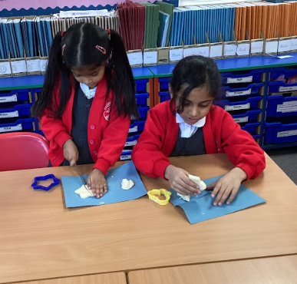
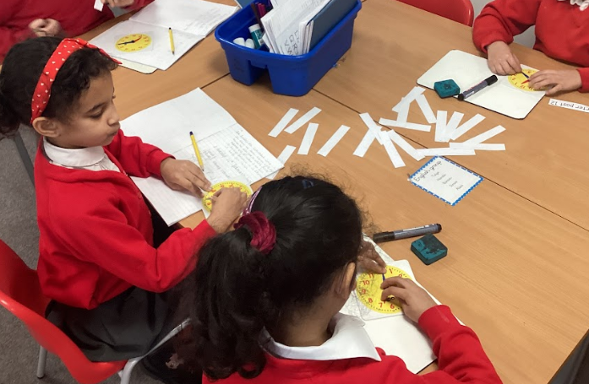
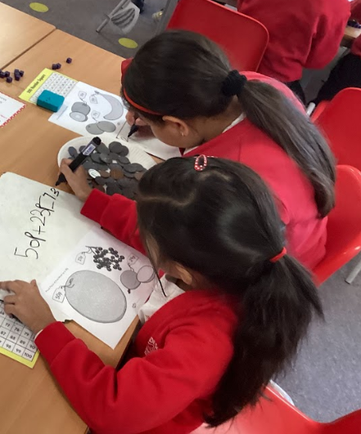
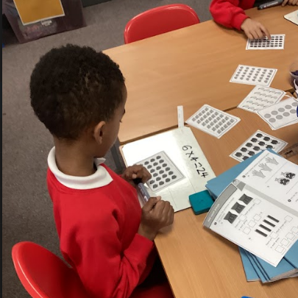
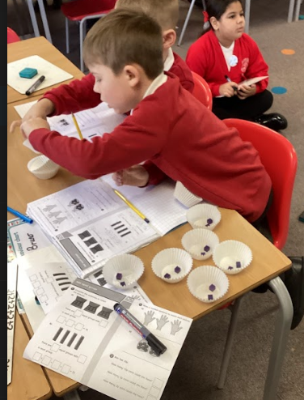
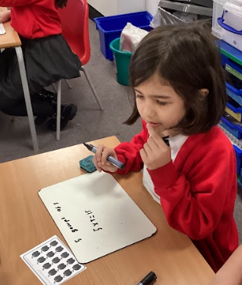
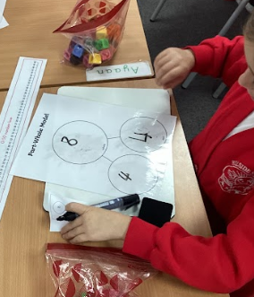
Learning Together Morning
Maths
07.11.25

Slide 2
Outline of the Morning
Understanding early maths skills taught in EYFS
Understanding Maths in KS1 (year 1 and year 2)
Ways to help at home
Accessible for all learners
Challenge

Slide 3

Maths at Hillside Infant School
At Hillside Infant School, we are committed to providing all our pupils with a strong foundation in mathematics. We use the WhiteRose Education scheme of work as a supporting resource, which aids in the development of mathematical fluency, reasoning, and problem-solving skills. While we use White Rose to support our teaching, we adapt and personalise the resources to ensure they meet the needs of all our pupils. Our approach encourages children to demonstrate their understanding of mathematics clearly and coherently.

Slide 4
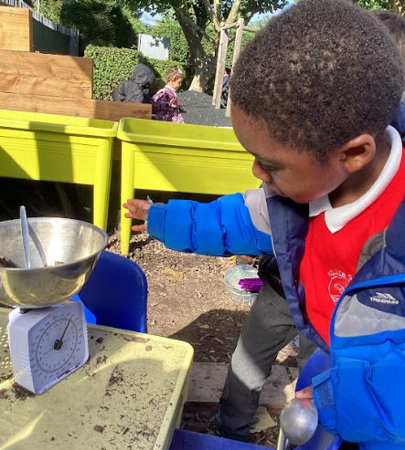
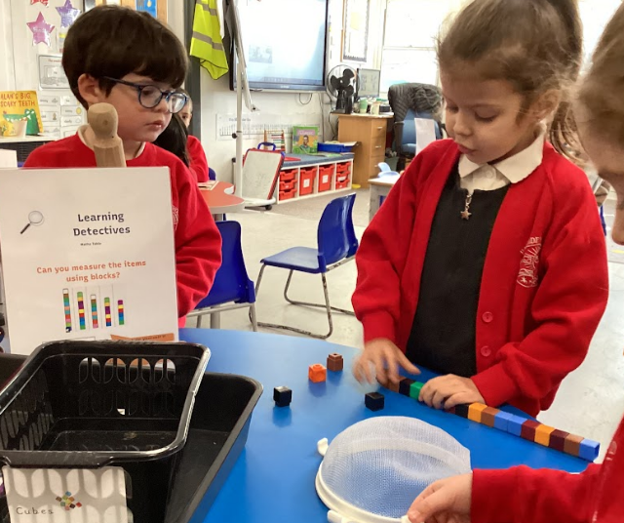
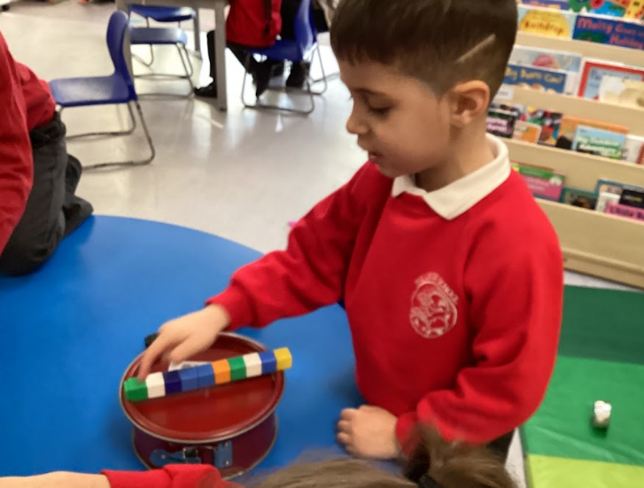
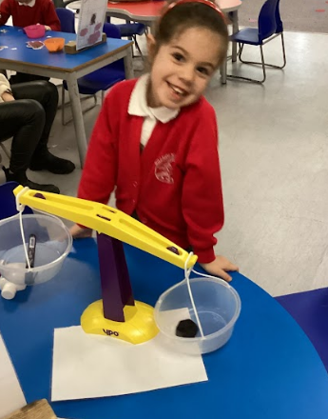
Why Early Maths Matters
Maths in the Early Years helps children make sense of the world around them. Through play and everyday experiences, they learn to count, recognise patterns, compare sizes, and talk about shapes and numbers. These early skills build their confidence and prepare them for future learning.

Slide 5
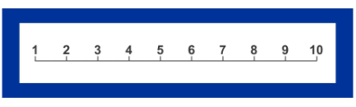
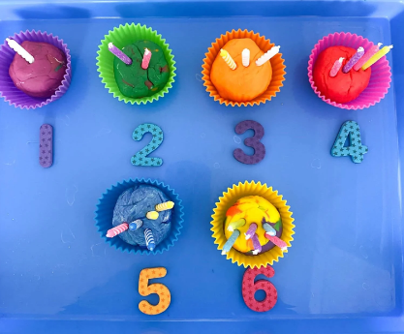
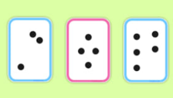
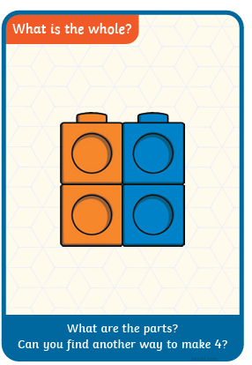
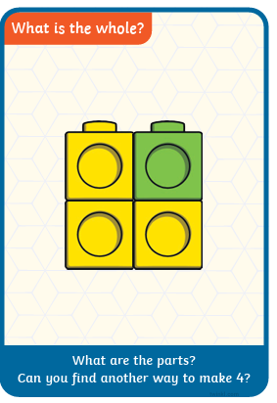
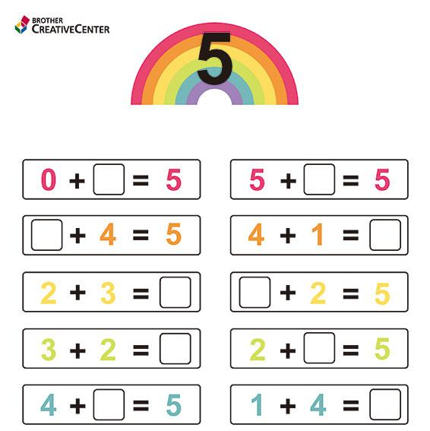
EYFS Maths Skills, more than just numbers!
Number
Have a deep understanding of numbers to 10 Explore and represent numbers up to 10, including how they can be made up (e.g. 7 is 5 + 2). Subitise (recognise quantities without counting) up to 5. Automatically recall number bonds to 5 and some to 10 (e.g. 3 + 2 = 5).

Slide 6
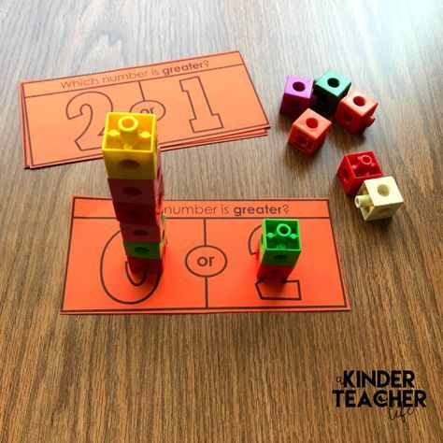
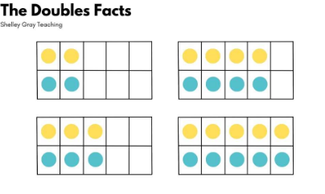
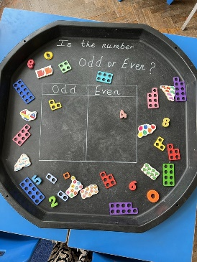
EYFS Maths Skills, more than just numbers!
Numerical Patterns
Verbally count beyond 20, recognising the pattern of the counting system. Compare quantities up to 10 in different contexts, recognising when one quantity is greater than, less than or the same as the other quantity. Explore and represent patterns within numbers up to 10, including evens and odds, double facts and how quantities can be distributed equally.
1 | 2 | 3 | 4 | 5
11 | 12 | 13 | 14 | 15

Slide 7
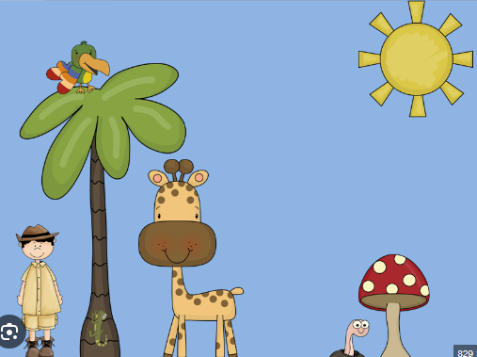
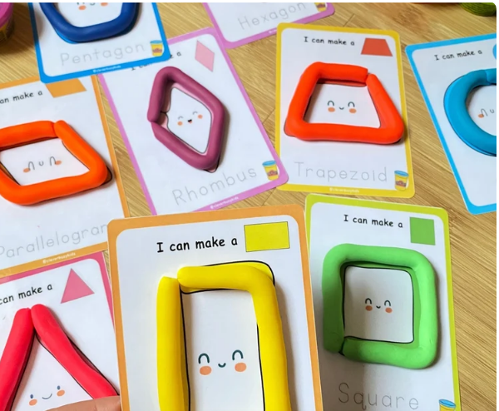
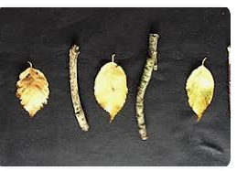
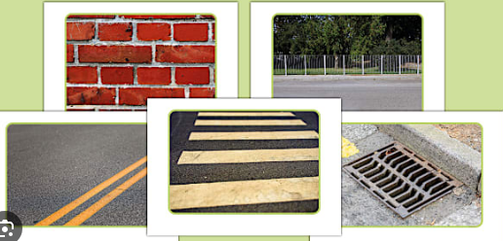
EYFS Maths Skills, more than just numbers!
Shape, space and Measure
Use and describe shapes and positional language (e.g. “next to”, “behind”, “under”). Compare length, weight, and capacity using everyday objects.

Slide 8
5 ways to encourage maths at home
1. Play with numbers | 2. Use everyday objects | 3. Mix guided and free play | 4. Talk about maths | 5. Make it fun and positive
Count Everything! Ask questions: How many steps to your bedroom? Can you give me three spoons? Look for patterns: We have 2 red socks and 2 blue socks, what is the same? | Use toys, coins, food or blocks to explore counting, sharing and sorting Try simple activites. Split 6 grapes between 2 plates. Build towers see which is taller Sort toys by colour, shape or size. | Let your child choose what they want to explore, but join in with questions and suggestions. How high can you build that tower? Can you put those cars in order from smallest to biggest? | Use mathematical words Bigger, smaller, heavier, lighter, more, less, altogether, half, double. Encourage children to explain what they notice. | Treat mistakes as learning opportunities Spot patterns together in everyday life- shapes in kitchen, tiles, numbers on doors, patterns on clothes. Turn maths into games: hide and seek, dice games, board games, or measuring ingredients when baking
Top Tip:
Short, playful, and frequent activities are more effective than long structured lessons. Children absorb maths through daily life and curiosity

Slide 9
KS1 Maths Skills (what they need to know)
Area | Year 1 Key Content | Year 2 Key Content
Place Value ( the value of each digit and its place) | Count to 100 forwards and backwards (broken into 20, 50, 100) | Recognise and understand the value of tens and ones from numbers up to 100
 | Recognise and use place value for numbers 1 – 100 (broken into to 20, 50, 100) | Compare and order numbers to 100 using < > and = signs
 | Count in steps of 2, 5 and 10 from 0 | Partition two-digit numbers into tens and ones ( 23 = 20 + 3)

Slide 10
KS1 Maths Skills (what they need to know)
Area | Year 1 Key Content | Year 2 Key Content
Addition and Subtraction | Add and subtract within 20 using objects and number lines | Add and subtract up to 100 using mental strategies and number lines
 | Use number bonds to 10 and 20 10 + 5 = 15. 20 – 5 = 15 | Solve addition and subtraction word problems
 | Solve simple one-step problems. | Use partitioning for adding and subtracting two digit numbers.

Slide 11
KS1 Maths Skills (what they need to know)
Area | Year 1 Key Content | Year 2 Key Content
Multiplication and Division | Understand that multiplication is repeated addition (2 + 2 + 2 = 6) | Recall and use multiplication facts for 2, 5 and 10 times tables
 | Understand division as sharing into equal groups | Solve division problems using the inverse relationship of multiplication.
 | Solve simple problems involving grouping and sharing | Use arrays to model multiplication and division

Slide 12
KS1 Maths Skills (what they need to know)
Area | Year 1 Key Content | Year 2 Key Content
Fractions | Recognise, find and name halves and quarters of shapes and amounts | Recognise and find simple fractions (1/2,1/3, 2/4) of shapes and sets
 |  | Understand equivalence (2/4 = ½)

Slide 13
KS1 Maths Skills (what they need to know)
Area | Year 1 Key Content | Year 2 Key Content
Throughout all units Working Mathematically | Solve simple problems using concrete materials (counters, shapes) | Solve simple problems using concrete materials and pictorial representations
 | Explain methods and solutions | Use reasoning and explain solutions clearly using appropriate mathematical language
 | Use mathematical vocabulary to describe and explain methods. | Apply mathematical concepts to real-world problems.

Slide 14
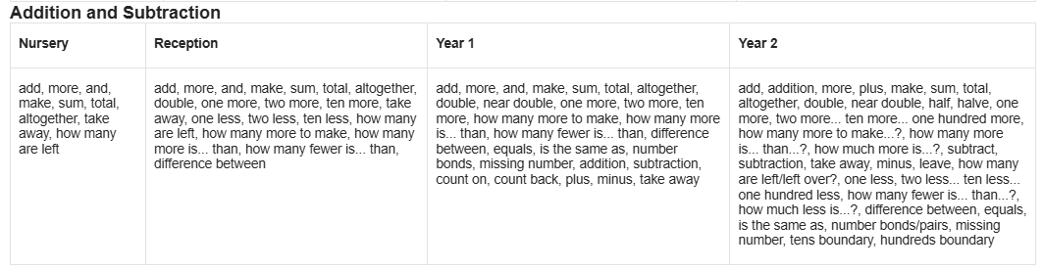
Vocabulary (Star words)

Slide 15
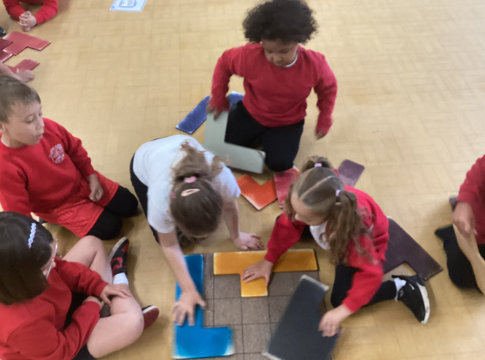
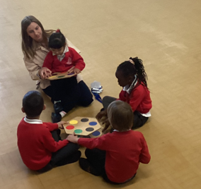
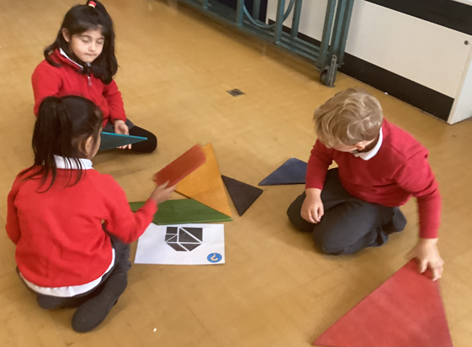
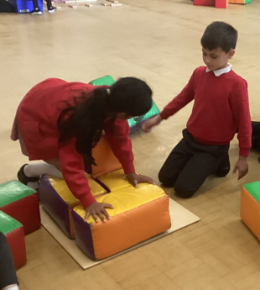
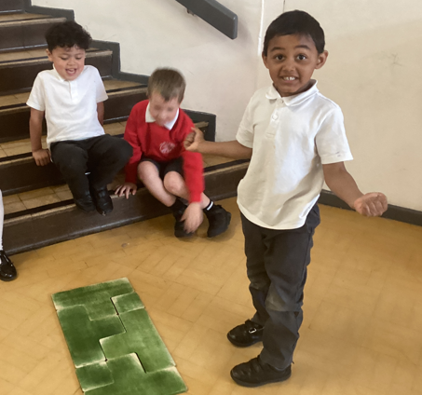
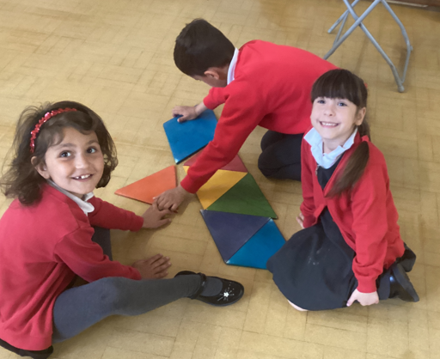
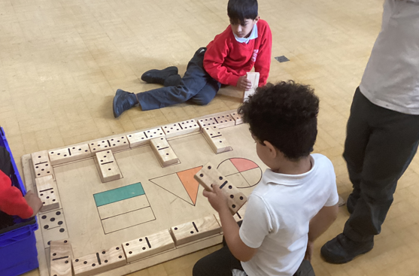
Maths in Action

Slide 16
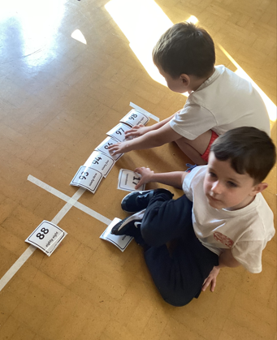
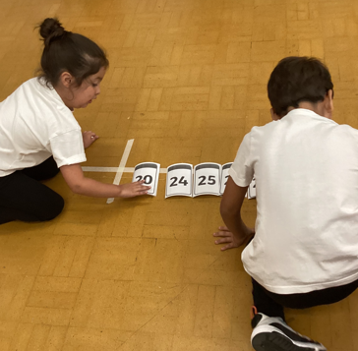
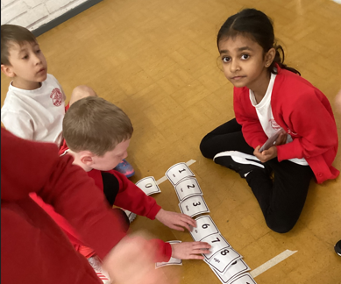
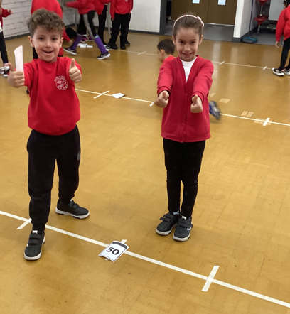
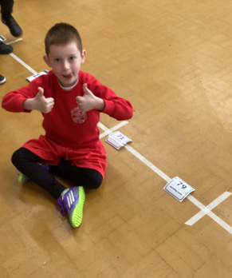
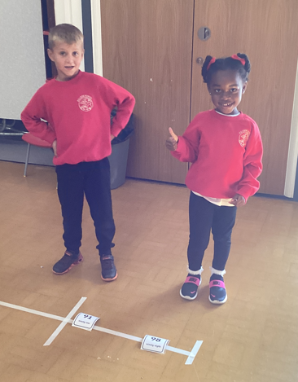
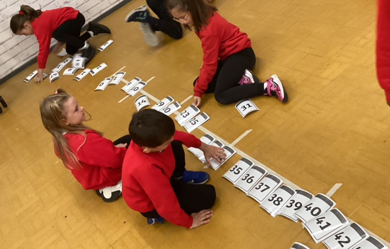
Maths in Action

Slide 17
Maths in Action

Slide 18
5 ways to encourage maths at home
1. Practice Number Facts Every Day (Just 10 Minutes!) | 2. Talk Maths - Use the Right Words | 3. Make Numbers Real - Use Objects You Have at Home | 4. Ask Questions - Develop Problem-Solving Skills | 5. Keep It Short, Keep It Regular
Count forwards and backwards in 1s, 2s, 5s and 10s Practice number bonds: "I say 7, you say...?" (3!) Quick addition and subtraction with toys, coins or snacks | "Which is greater - 5 or 8?" "Can you estimate how many steps to the door?" "What's the difference between these amounts?" "How do you know?“ “I know 5 is less than 8 because..." | Bundle 10 straws together with elastic bands, then make numbers (23 = 2 bundles + 3 single straws) "We have 50p. The apple costs 30p. How much change?" Cooking: Measure ingredients, halve or double recipes Setting the table: "We need 6 plates. We have 2. How many more?" | "How do you know?" and "Can you explain?“ Create simple word problems from daily life: "You have 12 grapes. You eat 5. How many left?“ "We need 20 biscuits. We have 13. How many more?“ Ask comparison questions: "Who has more? How many more?" Challenge: "Can you find another way to solve it?" | The Golden Rule: 10-15 minutes daily is better than 1 hour on Sunday!

Slide 19
Remember:
✨ Start where your child is comfortable, then stretch them slightly
✨ Make it active and fun - not just worksheets
✨ Mistakes are brilliant learning opportunities
✨ Your encouragement matters more than getting everything right.

Slide 20
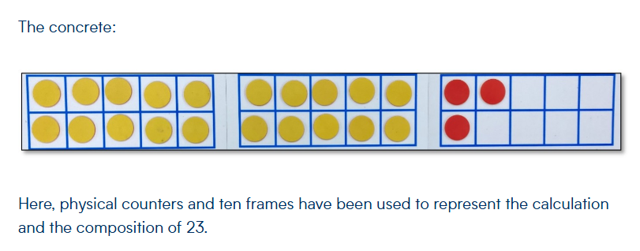
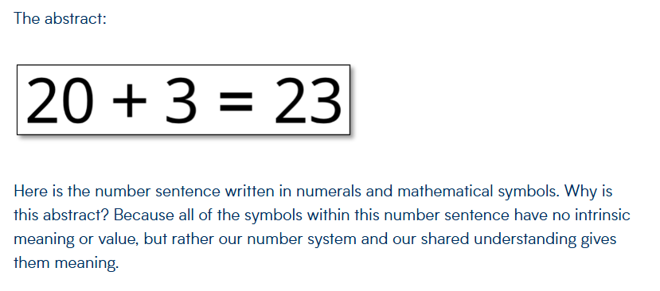
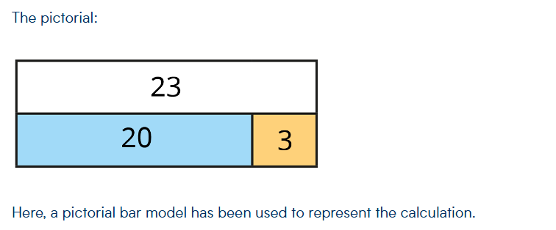
Accessible for all
Making maths accessible to all students is about ensuring every child can engage, understand, and succeed with the concepts, regardless of their starting point. Using the CPA approach (Concrete → Pictorial → Abstract) is a key strategy for this.

Slide 21
How We Challenge Higher-Attaining Pupils in Maths
1. Deepening Understanding through Reasoning
We encourage children to explain their mathematical thinking, not just find the answer. For example, when solving addition problems, we might ask:
“Can you explain how you worked that out?”
“Is there another way to solve this problem?”
“Can you prove your answer is correct?”
Children are also given statements to consider, such as “Double 12 is the same as 10 + 10 + 2 + 2. Do you agree? Why?”
This pushes them to reason and justify their answers.
2. Problem Solving
We regularly set open-ended problems that have more than one solution, or require several steps. For example:
Children are encouraged to explore, try different approaches, and explain the choices they make. This helps them develop perseverance and flexible thinking.
3. Applying Skills in New Contexts
Our higher-attaining pupils are given opportunities to apply their maths skills in unfamiliar situations, such as:
Solving word problems that link to real-life scenarios (e.g. planning a party within a budget).
Investigating patterns and making predictions (e.g. “If the sequence goes up by 3 each time, what will the 10th number be?”).

Slide 22
Example of how we challenge higher-attaining pupils in Maths
Topic: Number bonds to 10
What students know: 1 + 9 = 10, 2 + 8 = 10, etc.
Stretching outwards idea: Explore different representations and contexts of number bonds instead of moving to bigger numbers.
Activity Example: “Number Bonds in the World Around Us”
Story Context: “You have 10 strawberries. Some go in a basket, some on a plate. How many could be in each?”
Hands-on: Use counters, fruit, or toys to create different combinations that make 10.
Creative Extension:
  Draw the different combinations on paper or a whiteboard.
  Use different mediums: paint, stickers, or even movement (e.g., jump 2 steps, then 8 steps).
  Challenge them to find all possible combinations—some may try to repeat, so they can sort and organize their results.
Why it stretches outwards?
They aren’t learning bigger numbers yet, but they are:
  Applying their knowledge to real-life contexts
  Representing numbers in multiple ways (visual, physical, artistic)
  Developing reasoning skills by exploring all possibilities

Slide 23
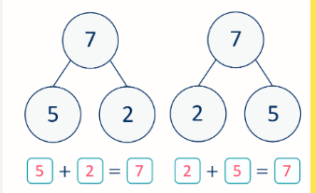
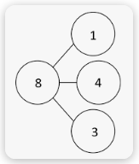
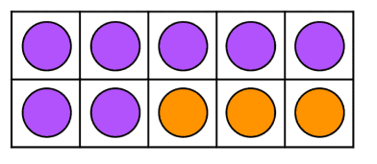
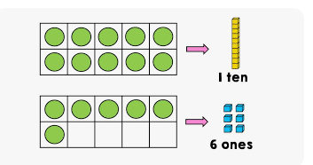
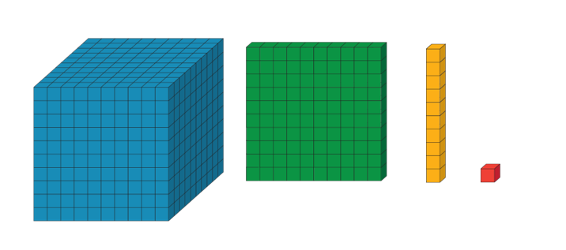
Resources that we use to support teaching
At tables you will see a range of resources that we use at school to support with maths.

Slide 24
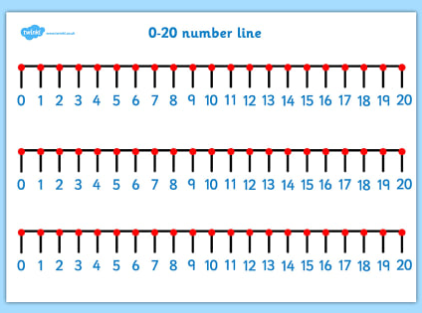
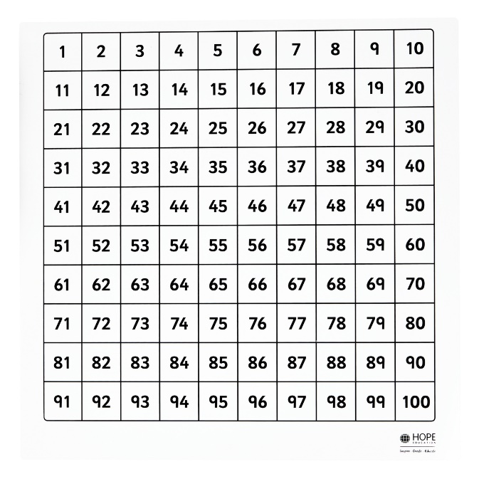
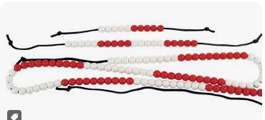


Resources that we use to support teaching
At tables you will see a range of resources that we use at school to support with maths.

Slide 25
Questions?
What you’ll see in classrooms
Reception (children are in their choosing time, take a clipboard and use the questions to try and incorporate maths into what they are doing)
Linking numbers to a picture
Subitising (different ways to show 4 and 5)
Making numbers 1-5 in different ways
Year 1
Addition - add together
Addition - add more (3 more than 7 is equal to 10)
Addition problems (Word problems)
Find a part ( __ + 3 = 7)
Year 2
Subtract to a 10 ( 15 - 5 = 10, 27 – 7 = 10)
Subtract across 10 ( 15 – 7 = 8, 27 – 9 = 18)
Subtract from a 10 ( 10 – 4 = 6, 75 – 5 = 70)
Subtract from a 10 (word problems involving 2 parts. I have 30 sweets, I give 2 to my sister and 3 to my brother, how many do I have left?)

